Slide 1
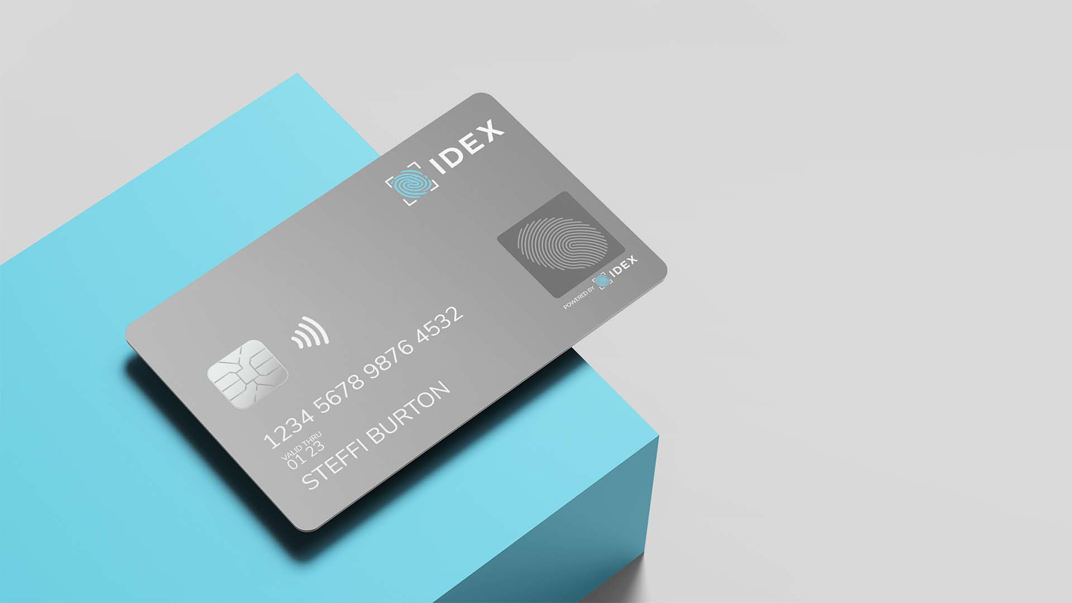
Enabling NextGen Smart Cards for Payments & Card-based Applications
February 2022
Oslo Børs: IDEX Nasdaq: IDBA
Copyright © 2022 IDEX Biometrics ASA

Slide 2
Disclaimer
This presentation includes forward-looking information and statements that are subject to risks and uncertainties that could cause actual results to differ. Such forward-looking information and statements are based on current expectations, estimates and projections about global economic conditions, the economic conditions of the regions and industries that are major markets for IDEX Biometrics ASA (IDEX) and its subsidiaries. These expectations, estimates and projections are generally identifiable by statements containing words such as "expects", "believes", "estimates" or similar expressions denoting uncertainty. Important factors that could cause actual results to differ materially from those expectations include, among others, economic and market conditions in the geographic areas and industries that are or will be markets we target, market acceptance of new products and services, changes in governmental regulations, interest rates, fluctuations in currency exchange rates, and such other factors as may be discussed from time to time. Although IDEX believes its expectations and the information set forth in this presentation were based upon reasonable assumptions at the time when they were made, it can give no assurance that those expectations will be achieved or that the actual results will be as described in this presentation. IDEX is not making any representation or warranty, expressed or implied, as to the accuracy, reliability, or completeness of the information in this presentation, and neither IDEX nor any of its directors, officers, or employees will have any liability to you or any other persons resulting from your use of the information in this presentation. IDEX undertakes no obligation to publicly update or revise any forward-looking information or statements in this presentation.
Copyright © 2022 IDEX Biometrics ASA
Copyright © 2021 IDEX Biometrics

Slide 3
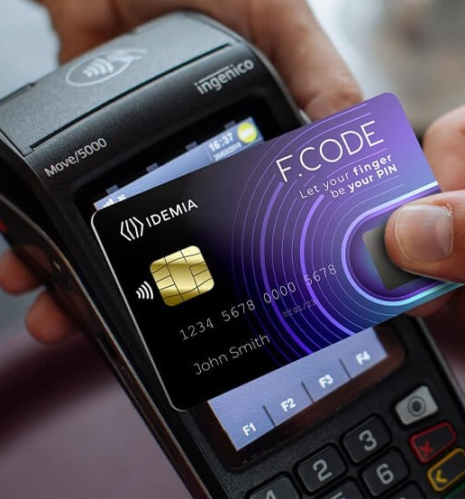



IDEX Biometrics – The Next Generation of Payments
Capturing a Market Inflection Point
Superior Biometric Performance
Disruptive System Costs
Multi-billion Market Opportunity
$$
Copyright © 2022 IDEX Biometrics ASA

Slide 4

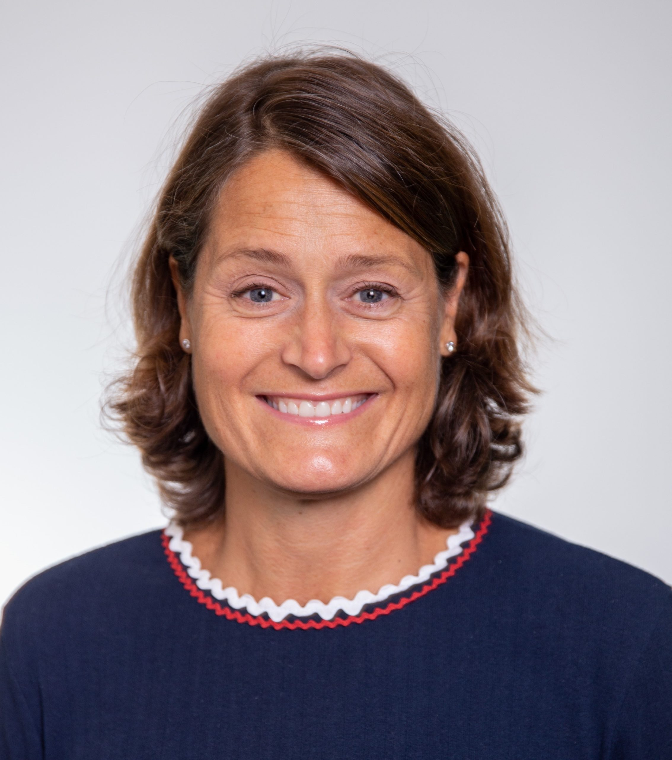





























Highly Experienced Leadership Team
Vince Graziani
CEO
Catharina Eklöf
CCO
Jamie Simms
CFO
Stan Swearingen
SVP-Strategy
Anthony Eaton
CTO
Fred Benkley
SVP-Innovation
Chris Ludden
SVP-Engineering
Copyright © 2022 IDEX Biometrics ASA

Slide 5
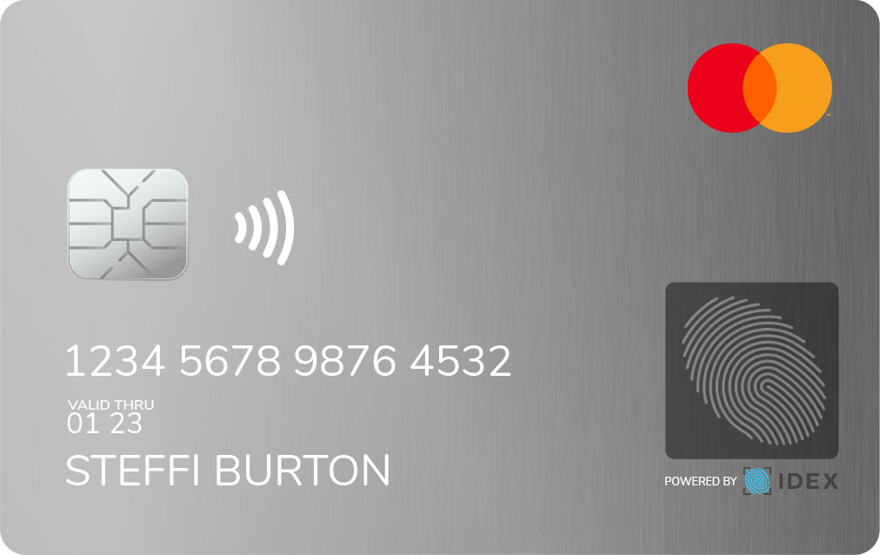
The Case for Card-based Fingerprint Authentication
Reduced fraud:
Secure, high-value
contactless transactions
Challenges
Fraud
Identity protection:
Encrypted biometric data; stored only on the card
Security
Ease of use:
Simple, low-cost enrolment
Seamless user experience
User Convenience
Card Economics
Economic benefits:
New customer acquisition
“Top of Wallet” effect
Direct Monetization
Copyright © 2022 IDEX Biometrics ASA
Notes:
Problem – Solution slide. Narrative could address “why now?” question.

Slide 6
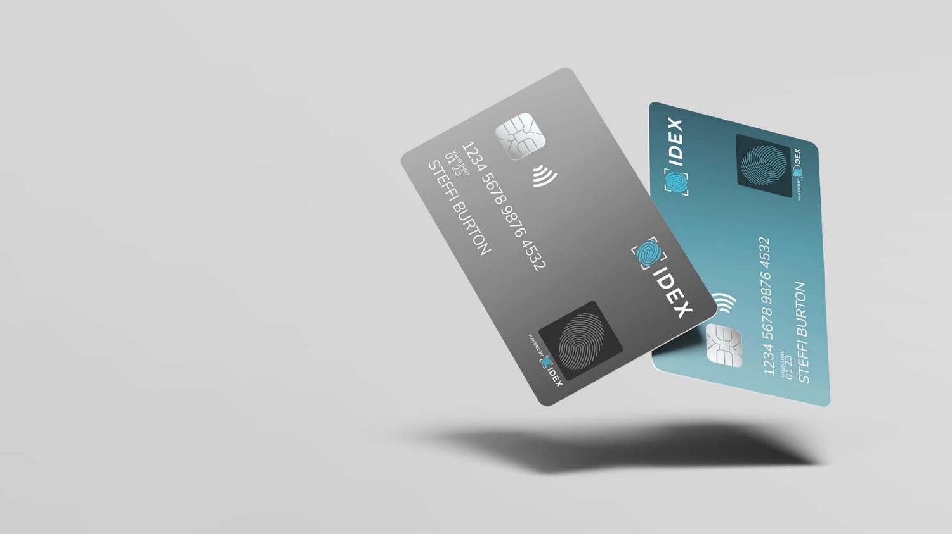
The Opportunity
Copyright © 2022 IDEX Biometrics ASA

Slide 7

Rapid Scaling of Biometric Payment Cards
Total market: ~5 Billion smart cards per year
  Includes all cards with secure element
Addressable Market: payment cards
  >3.0 billion payment smart cards per year
Serviceable Market: dual interface payment cards
  >1.9 billion contactless cards per year, growing at >8% CAGR
  Biometric penetration rate is rising faster than contactless adoption
  Forecasting 18% penetration by 2025, representing > 500 million cards
Multi-Billion $ SAM in payment cards alone
  Only two established competitors
  Market regulations limit threat of new low-cost competitors
>$1B-$2B
Copyright © 2022 IDEX Biometrics ASA

Slide 8











Primary Target: Biometric Payment Cards
Yearly Issuance of Payment Card Types
2021: A Market Inflection Point
Biometric Cards
Payment Infrastructure Already in Place
Standards established and certifications in place
Banks and issuers launching:
  Started with BNP Paribas in 2021
  Several Swedish banks launching in 2022
  Expecting double digit bank launches
  globally in 2022
Contactless Cards
Pin and chip Cards
Total Payment Cards
3 Bn
2 Bn
Contactless (NFC) = 8 years
1 Bn
Chip & PIN (Contact) = 18 years
Scaling faster
than contactless
1995
1996
1997
1998
1999
2000
2001
2002
2003
2004
2005
2006
2007
2008
2009
2010
2011
2012
2013
2014
2015
2016
2017
2018
2019
2020
2021
2022
Copyright © 2022 IDEX Biometrics ASA
Copyright © 2021 IDEX Biometrics

Slide 9



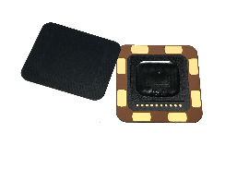





China’s Digital Currency Initiative Could Double our SAM
China’s central bank and digital currency: e-CNY
  >400 million people targeted by this central bank initiative (six participating regional banks)
  Initial deployment for Winter Olympics 2022
Greater than $1billion opportunity
  Digital currency requires enhanced security
  Secure off-line payment device:
  Hardware wallet
….IDEX partners engaged with all 6 regional banks;
two bank trials announced so far…
…enabled by major Chinese partnerships
Copyright © 2022 IDEX Biometrics ASA
Notes:
Take the opportunity to explain why the DCEP card is different, extra memory and security, etc.
Emphasize the enormity of the Chinese opportunity (potential to double SOM)
60 other countries’ central banks assessing DCEP

Slide 10










Long-term Vision: Universal Security Device
Biometrically-enabled cards secure a range of applications
Payment (card present and card not present)
Cybersecurity / Data Access
Access Control (Physical)
Central Bank Digital Currency (CBDC) wallet
Public Transportation / Ticketing
Healthcare and Government ID
An off-cloud personal security device to protect
a range of mobile and internet applications
Each application represents
a multi-billion card opportunity
Copyright © 2022 IDEX Biometrics ASA
Copyright © 2021 IDEX Biometrics
Notes:
Conclude this section with a discussion of all the opportunities we could be pursuing in the years ahead…

Slide 11
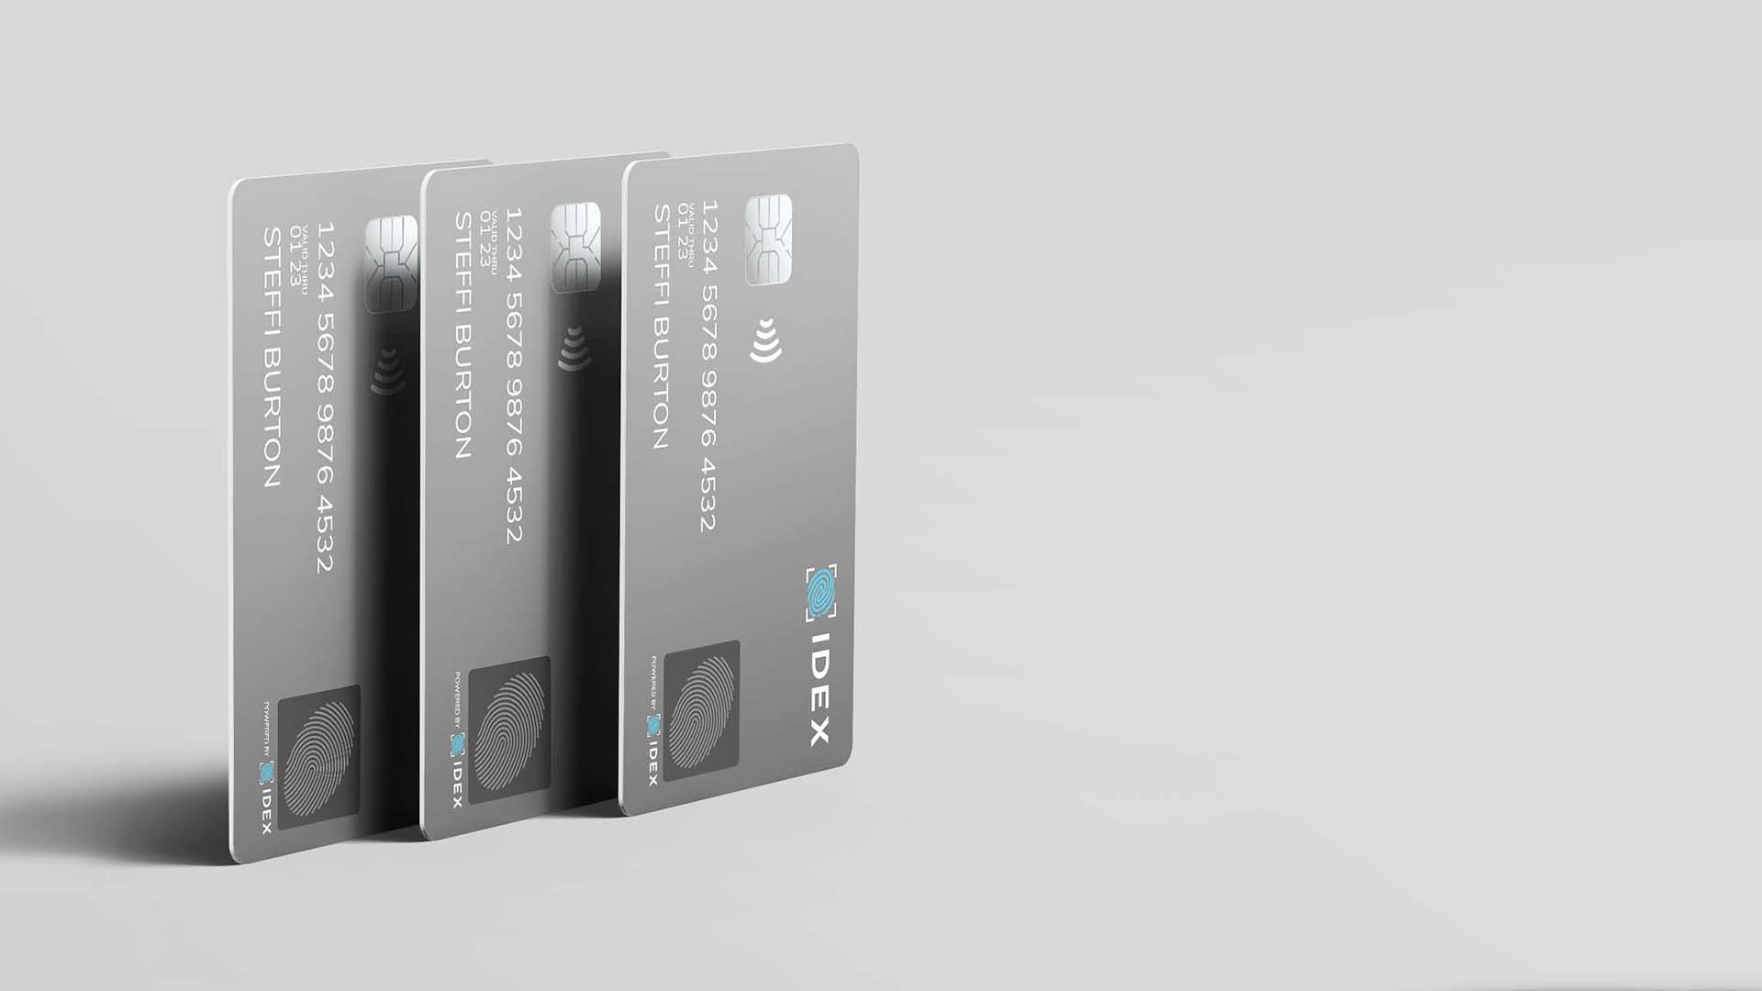
Competitive
Advantage
The Opportunity
Copyright © 2022 IDEX Biometrics ASA
Copyright © 2021 IDEX Biometrics

Slide 12






Superior Technology Drives Differentiation
Disruptive card architecture
Disruptive cost
Performance leadership
Versatile enrollment options
Flexible and comprehensive solution
Copyright © 2022 IDEX Biometrics ASA
Notes:
What are our key points of differentiation?
Read through with minimal commentary, then take a moment to click on the card image to run the video. Highlight the exploded view of the card, pointing out the inlay. This will provide a segue to the next slides.

Slide 13
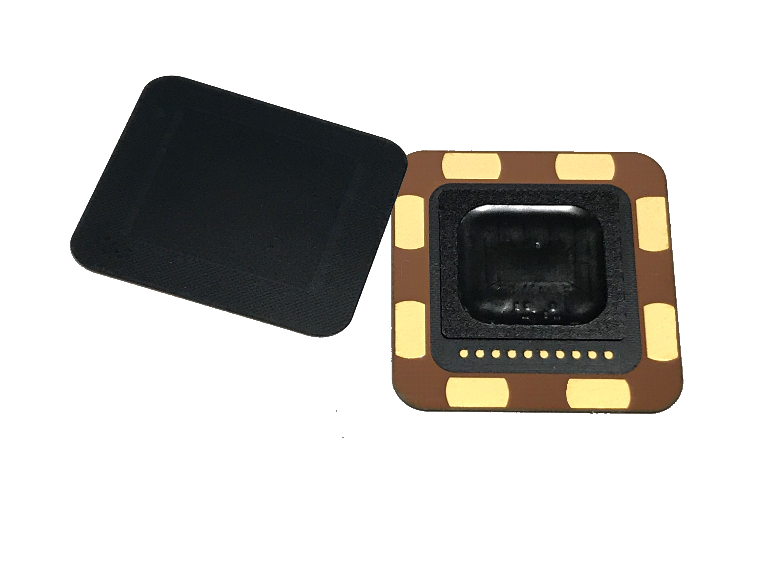
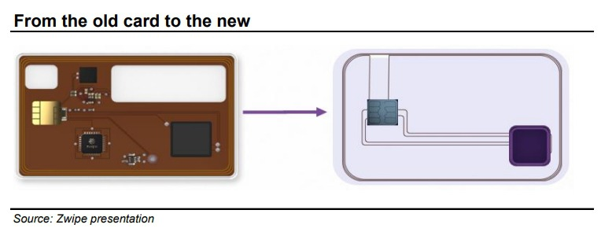
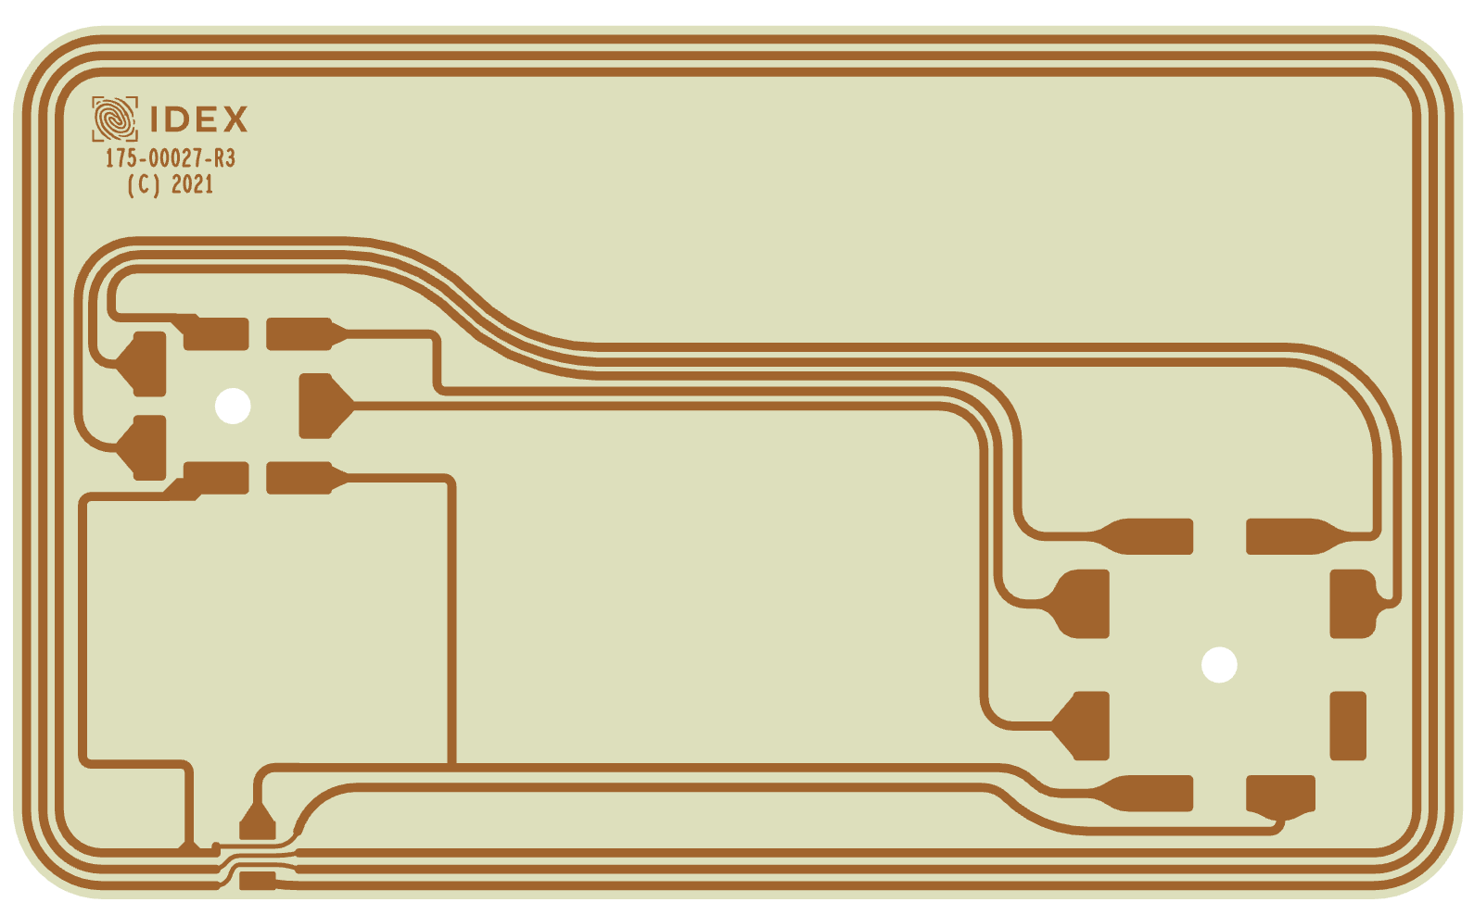
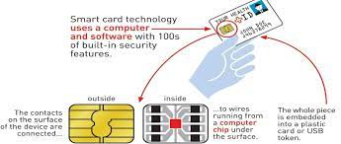
The TrustedBio Architectural Advantage
IDEX TrustedBio
Card Architecture
Simple Bill of Materials (BOM) driven by integration:
  TrustedBio System in Package
  EMVco – Certified Secure Element
Passive card inlay = lower cost & improved yield
Commodity Sensor
Card Architecture
Complex Bill of Materials required:
  Silicon Sensor
  MCU: biometric processor
  PMIC: power management
Active card inlay with numerous components
Total Card Cost: ~$5
Total Card Cost: >$15
Copyright © 2022 IDEX Biometrics ASA

Slide 14
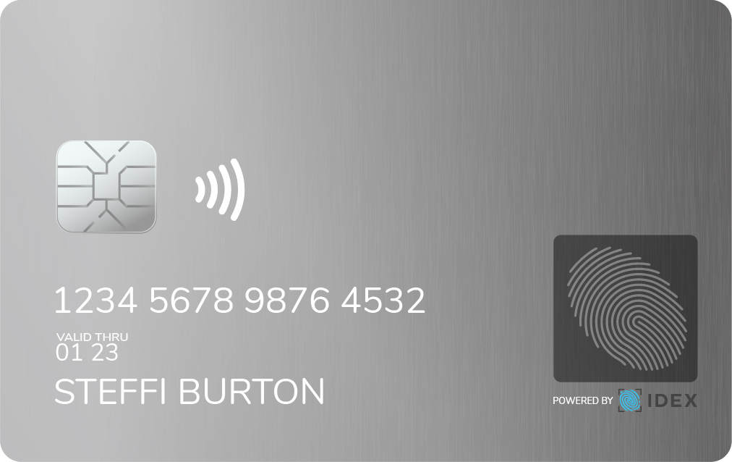


Infineon Partnership Enables Complete Solution
Accelerates time to revenue and improves margins
Infineon SLC38
Latest Generation
Secure Element
IDEX
TrustedBio Max
Fully integrated design enables:
  Lowest cost profile of any solution
  Rapid time to market
Game changing performance:
  Biometric process time: ~250ms
  Total transaction time (with EMV):~500ms
  Market-leading False Reject Rate
  EMV Pre-certification
Turnkey Card Design
Complete Solution
Infineon is the market share leader for security ICs globally
Copyright © 2022 IDEX Biometrics ASA
Copyright © 2021 IDEX Biometrics
Notes:
Infineon and IDEX have been working on this joint solution for well over 1 year
Infineon also sees biometric cards as an important and growing market. IFX CEO mentioned our partnership announcement in their quarterly results conference call.
The best performing, lowest cost solution in the industry
Enables a seamless user experience compared to standard contactless cards.
Customers can order development systems to begin testing and software development for their desired applications
“On the security side, we have announced a reference design for the next-generation biometric smart card architecture together with the Norwegian biometric specialist IDEX. It enables fingerprint authentication with low latency, high accuracy and power efficiency. The integration of the fingerprint sensor, the secure element, power management and communications reduce the complexity of card manufacturing, which shortens time to market and lowest cost.”

Slide 15





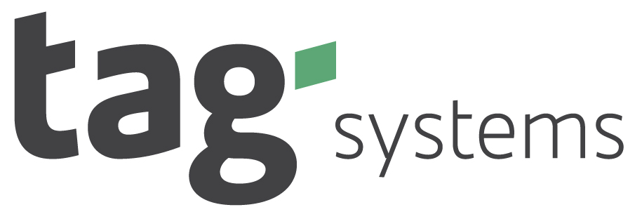




Ecosystem Partners are Key to Sales Strategy
IDEX works jointly with partners to drive demand across the value chain
Secure Elements
Card Manufacturers
Banks and Issuers
Inlay
Personalization
Sensor/Matcher/OS
Processors
IDEX and technology partners
Drive design-wins with card manufactures
Enable biometric card manufacturing
IDEX and card manufacturing partners
Drive demand with Banks and Issuers
Enable personalization bureaus and processors to support biometric cards
Through our partners IDEX can address greater than 70% of the payment card market
Copyright © 2022 IDEX Biometrics ASA
Notes:
Message: Biometric cards require new technology and system expertise. Hardware, Software, manufacturing etc. This new expertise represents a large percentage of the new Chain. IDEX positioned to capture value in the expanded chain.

Slide 16


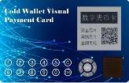
2021: A Pivotal Year for Commercialization
IDEMIA gaining significant market traction
IDEX/Infineon platform with industry leading performance
Network certification for IDEX solutions
Unlocking another $1B+ SAM: e-CNY
Staying ahead of competition
Building order backlog and mass production order to support commercial launches in 2022
Infineon is the world’s leading provider of secure elements.
6 new design wins since launch
Rapid adoption of leading card makers and issuers
e-CNY biometric Hard Wallet roll-out anticipated in 2H 2022
TrustedBio MAX™:
The most advanced and integrated biometric payment solution ever created
Copyright © 2022 IDEX Biometrics ASA

Slide 17
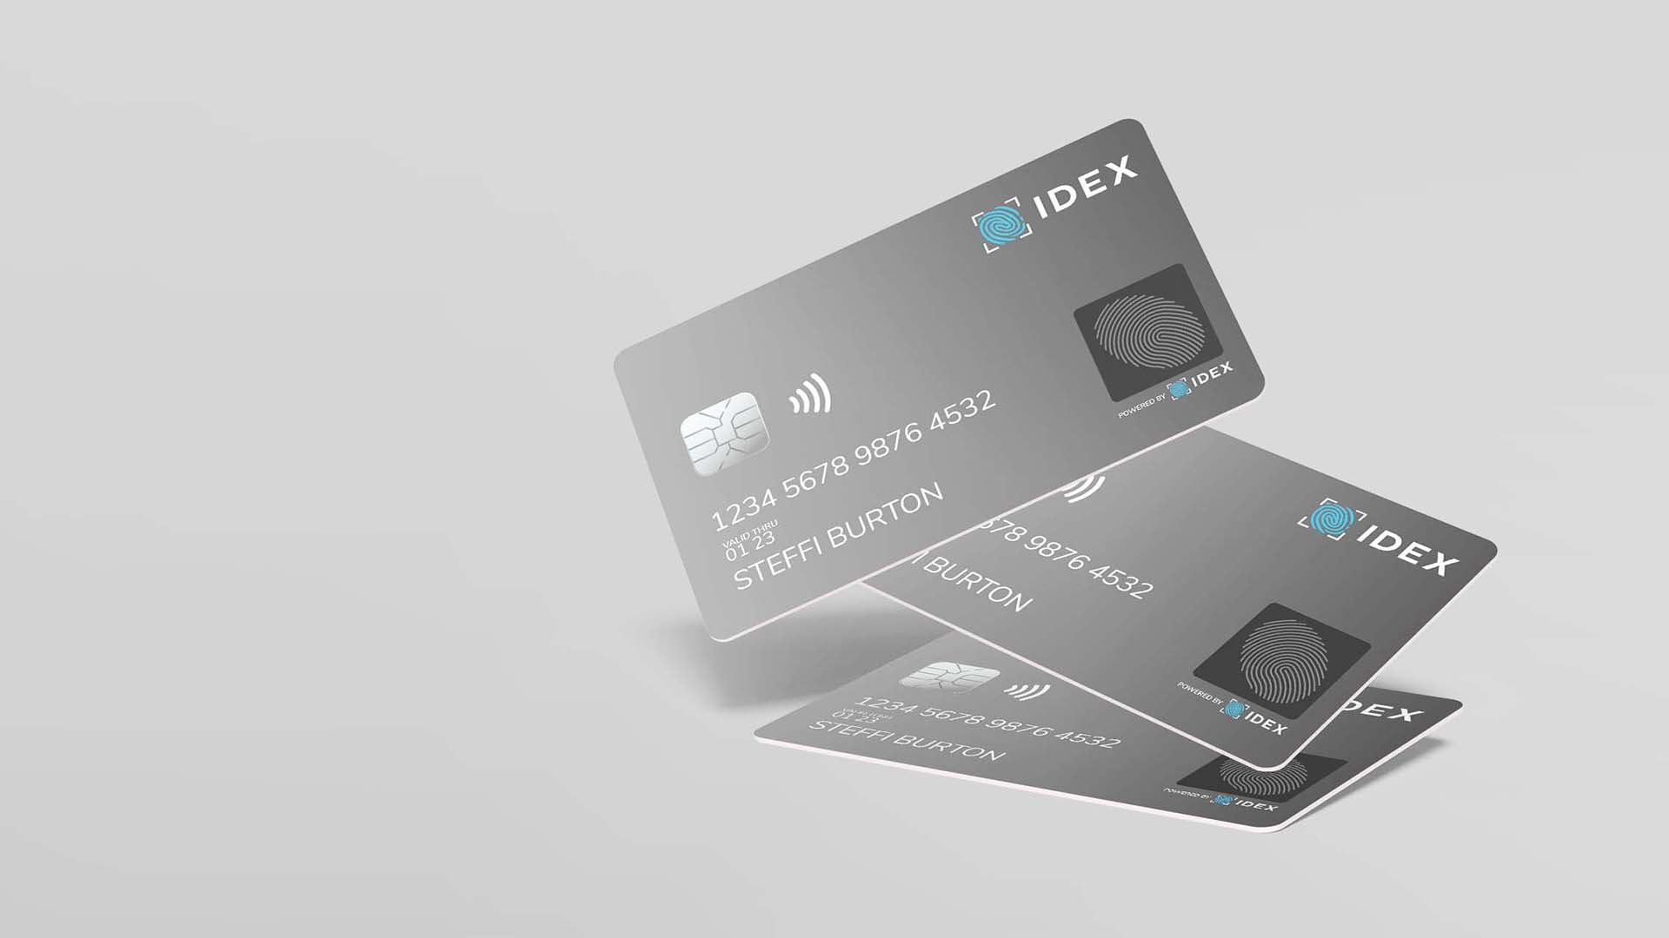
Financial
Profile
Copyright © 2022 IDEX Biometrics ASA

Slide 18
Q4 2021 Financial Summary
Revenue trends remain positive
  Continued growth in payments
  Sustained shipments for logical access
  First shipments for Cyber/Access control
Sequential expense fluctuation:
  ~$1.2M FX accounting – non-cash
  ESPP charge (non-cash)
  Achievement-based compensation accrual
  Transition from R&D to Commercial focus
Cash balance
$33.8 million as of December 31
Copyright © 2022 IDEX Biometrics ASA

Slide 19
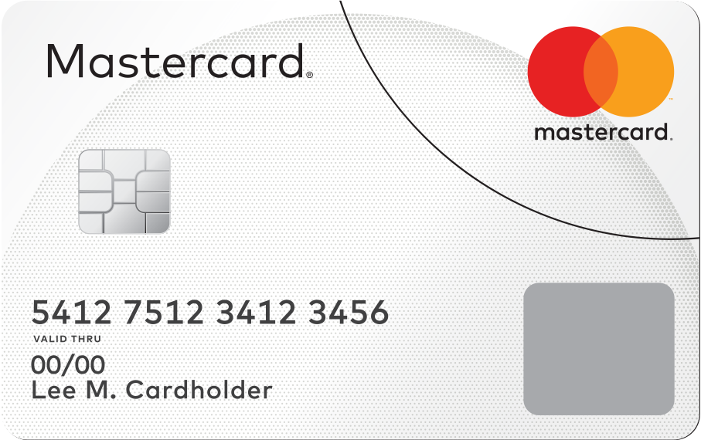
Strong Operating Leverage in Long-term Model
Potential for extraordinary revenue growth
Expanding opportunity pipeline
Rapidly increasing backlog and pending design wins
Target Operating Model at Scale:
Scalable fabless semiconductor model
50%+ gross margins
  Consistent with fabless model
  Reflects differentiation and solution cost leadership
~30% operating margins
Scalable for sustained cash flow
  Concentrated customer base limits channel expenses
  Low CapEx and leveraged OpEx
Copyright © 2022 IDEX Biometrics ASA
Copyright © 2021 IDEX Biometrics

Slide 20
Summary
Copyright © 2022 IDEX Biometrics ASA

Slide 21
IDEX Biometrics – Differentiated and Disruptive
Capturing a Market Inflection Point: Commercial engagements with industry leaders driving market adoption
Superior Biometric Performance: Enabling a secure and seamless user experience at ground-breaking transaction speeds
Disruptive System Costs: Unique sensor architecture enables high integration and lowest possible cost
Massive Addressable Market: Payment cards, Cybersecurity / Data Access, Digital Currencies, and other adjacent markets
$$
Copyright © 2022 IDEX Biometrics ASA

Slide 22
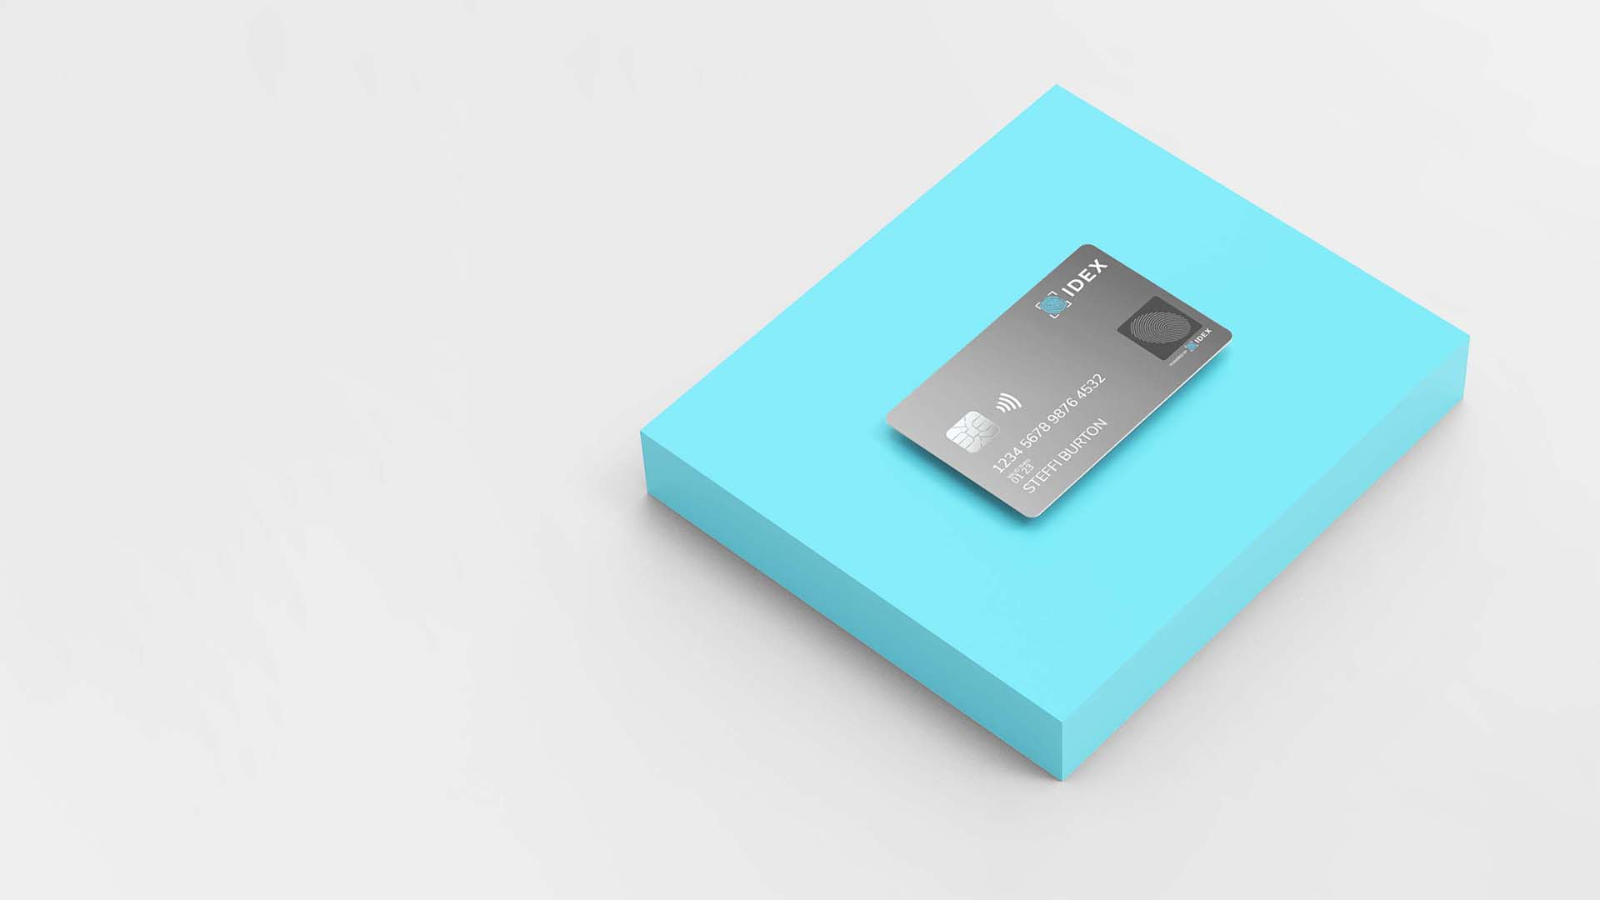
Thank you!
Copyright © 2022 IDEX Biometrics ASA

