Slide 1
BW Ideol
Q4 2021 presentation
24 February 2021
CEO - Paul De La Guérivière
CFO - Nicolas De Kerangal

Slide 2
Disclaimer
This Presentation and its appendices (the "Presentation") has been produced by BW Ideol AS (the "Company", and together with its direct and indirect subsidiaries, the "Group") solely for information purposes. This document and the information contained herein is being made available on a strictly confidential basis and may not be disclosed, reproduced or redistributed, directly or indirectly, to any other person or published or used in whole or in part, for any purpose. This Presentation, and the information contained herein, does not constitute or form part of, and is not prepared or made in connection with, an offer or invitation to sell, or any solicitation of any offer to subscribe for or purchase any securities of the Company and nothing contained herein shall form the basis of any contract or commitment whatsoever. By attending a meeting where this Presentation is made, or by reading the Presentation slides or by otherwise receiving this Presentation or the information contained herein, you agree to be bound by the following terms, conditions and limitations. Any failure to comply with the restrictions set out herein may constitute a violation of applicable securities laws or may result in civil, administrative or criminal liabilities. For the purposes of this notice, “Presentation” means and includes this document and its appendices, any oral presentation given in connection with this Presentation, any question-and-answer session during or after such oral presentation and any written or oral material discussed or distributed during any oral presentation meeting. No representation, warranty or undertaking, express or implied, is made by the Company, its affiliates or representatives as to, and no reliance should be placed on, the fairness, accuracy, completeness or correctness of the information or the opinions contained herein, for any purpose whatsoever. Neither the Company nor any of its affiliates or representatives shall have any responsibility or liability whatsoever (for negligence or otherwise) for any loss whatsoever and howsoever arising from any use of this Presentation or its contents or otherwise arising in connection with this Presentation.
This Presentation speaks as of the date hereof. All information in this Presentation is subject to updating, revision, verification, correction, completion, amendment and may change materially and without notice. None of the Company, its affiliates or representatives undertakes any obligation to provide the recipient with access to any additional information or to update this Presentation or any information or to correct any inaccuracies in any such information. The information contained in this Presentation should be considered in the context of the circumstances prevailing at the time and has not been, and will not be, updated to reflect developments that may occur after the date of this Presentation. These materials do not purport to contain a complete description of the Group or the market(s) in which the Group operates, nor do they provide an audited valuation of the Group. The analyses contained in these materials are not, and do not purport to be, appraisals of the assets, stock or business of the Group or any other person. Moreover, these materials are incomplete without reference to, and should be viewed and considered solely in conjunction with, the oral briefing provided by an authorised representative of the Company in relation to these materials. The Company have not authorised any other person to provide any persons with any other information related to the Group and the Company will not assume any responsibility for any information other persons may provide.
The contents of this Presentation are not to be construed as financial, legal, business, investment, tax or other professional advice. Each recipient should consult with its own financial, legal, business, investment and tax advisers to receive financial, legal, business, investment and tax advice. In particular, nothing herein shall be taken as constituting the giving of investment advice and these materials are not intended to provide, and must not be taken as, the exclusive basis of any investment decision or other valuation and should not be considered as a recommendation by the Company (or any of their affiliates) that any recipient enters into any transaction. These materials comprise a general summary of certain matters in connection with the Group. These materials do not purport to contain all of the information that any recipient may require to make a decision with regards to any transaction. Any decision as to whether or not to enter into any transaction should be taken solely by the relevant Recipient. Before entering into such transaction, each recipient should take steps to ensure that it fully understands such transaction and has made an independent assessments of the appropriateness of such transaction in the light of its own objectives and circumstances, including the possible risks and benefits of entering into such transaction.
This Presentation contains forward-looking information and statements relating to the business, financial performance and results of the Group and/or industry and markets in which it operates. Forward-looking statements are statements that are not historical facts and may be identified by words such as "aims", "anticipates", "believes", "estimates", "expects", "foresees", "intends", "plans", "predicts", "projects", "targets", and similar expressions. Such forward-looking statements are based on current expectations, estimates and projections, reflect current views with respect to future events, and are subject to risks, uncertainties and assumptions. Forward-looking statements are not guarantees of future performance and risks, uncertainties and other important factors could cause the actual results of operations, financial condition and liquidity of the Group or the industry to differ materially from this results expressed or implied in this Presentation by such forward-looking statements. No representation is made that any of these forward-looking statements or forecasts will come to pass or that any forecast result will be achieved and you are cautioned not to place any undue influence on any forward-looking statement.
The recipient acknowledges and accepts that it will be solely responsible for its own assessment of the Group, the market, the Group's market position, the Group's funding position, and the potential future performance of the Group's business and the Company's shares. The Company's shares have not been and will not be registered under the United States Securities Act of 1933, as amended (the "U.S. Securities Act"), or with any securities regulatory authority of any state or other jurisdiction in the United States, and may not be offered, sold, resold, pledged, delivered, distributed or transferred, directly or indirectly, into or within the United States, absent registration under the U.S. Securities Act or under an exemption from, or in a transaction not subject to, the registration requirements of the U.S. Securities Act or in compliance with any applicable securities laws of any state or jurisdiction of the United States. Accordingly, any offer or sale of securities will only be offered or sold (i) within the United States or to U.S. Persons, only to qualified institutional buyers as defined under Rule 144A under the Securities Act ("QIBs") in offering transactions not involving a public offering and (ii) outside the United States in offshore transactions in accordance with Regulation S. Any purchaser of securities in the United States, or to or for the account of U.S. Persons, will be deemed to have been made certain representations and acknowledgements, including without limitation that the purchaser is a QIB.
The Company has not authorized any offer to the public of securities, or has undertaken or plans to undertake any action to make an offer of securities to the public requiring the publication of an offering prospectus, in any member state of the European Economic Area. No prospectus has or will be prepared in connection with this Presentation and the information contained herein. This Presentation is only addressed to and directed at persons in member states of the European Economic Area who are "qualified investors" within the meaning of Article 2 (E) of the Prospectus Regulation (Regulation (EU) 2017/1129).
Neither this Presentation nor the information contained herein is being issued, and nor may this Presentation nor the information contained herein be distributed, directly or indirectly, to or into any jurisdiction in which such issuance and/or distribution would be unlawful.
By accepting these materials, each recipient represents and warrants that it is able to receive them without contravention of an unfulfilled registration requirements or other legal or regulatory restrictions in the jurisdiction in which such recipients resides or conducts business. This Presentation is subject to and governed by Norwegian law, and any dispute arising in respect of this Presentation is subject to the exclusive jurisdiction of Norwegian courts with Oslo District Court as exclusive legal venue.

Slide 3
Agenda
BW Ideol value proposition
Operational highlights
Firming up and expanding project pipeline with strong partners
Financial overview
Summary and outlook
Appendix

Slide 4





A unique value proposition
A proven and robust technology with no impact on the wind turbine performance
A cost optimum from design to operation applied to the entire generation asset
A solution providing flexibility to maximize local content
A unique risk coverage proposition encompassing the floater-turbine integration
A demonstrated industrialization process meeting the supply chain requirements
Over 10 years of floating wind experience on multiples projects offering a unique credibility and capacity to mitigate risks

Slide 5
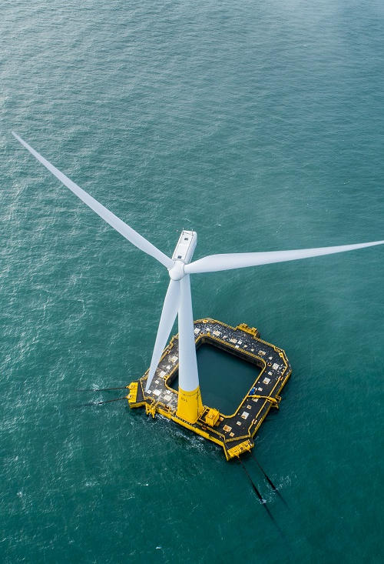
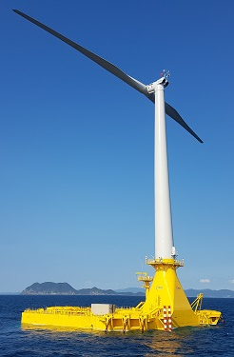
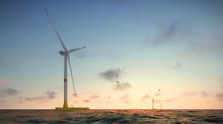
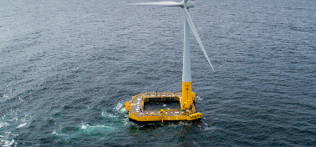
Unlocking the full potential of offshore wind
Hibiki
Japan 2018
One of the few companies with over 10 years of engineering, execution and maintenance experience in floating wind
Sizeable project pipeline as co-developer in Japan, Europe and the US
ScotWind 960MW project development rights awarded
in January 2022
EolMed 30MW project to enter construction phase in H1-2022
More than three years of operational experience from two full-scale demonstrators in France and Japan
Integrated team of 70 experts in France, Japan and the US supported by BW Offshore’s unique experience, services and resources
Listed on Euronext Growth Oslo since March 2021 (ticker: BWIDL)
Floatgen
France 2018
EolMed
France 30 MW
ScotWind
Scotland 960 MW

Slide 6
Operational highlights
1

Slide 7

Important milestones passed in a fast-growing market
Secured close to 1GW of floating offshore wind acreage in ScotWind leasing round as part of the Floating Energy Allyance
Signed investment agreement with JERA and ADEME Investissement for financing of floating wind projects
Acquistion of 5% ownership in 30MW EolMed floating wind pilot project
California Pilot Project progressed to Environmental Impact Report, final step before permitting
Cash position of EUR 33 million at year-end supporting growth strategy

Slide 8
Firming up and expanding project pipeline with strong partners
2

Slide 9

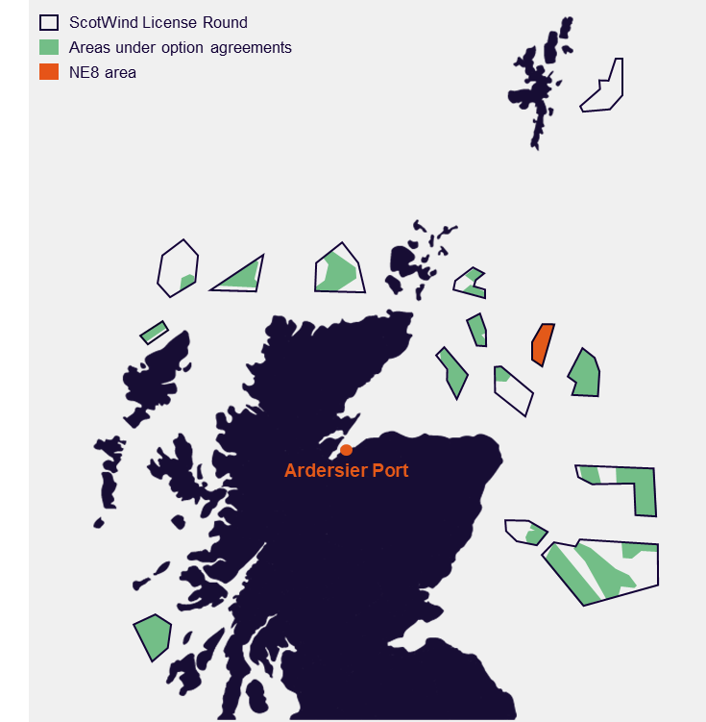
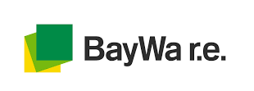

Awarded transformational 1GW ScotWind project
Consortium with BayWa r.e. and Elicio 33.3% ownership each
Unique combination of experience in offshore wind, floating wind and Scottish wind project development
Exclusivity on 330 km² area with potential for 960MW capacity
More than 3 years of stakeholder-engagement by CES¹ and the consortium
Excellent wind conditions, protected from the most severe waves, water depth between 75 and 105 m
Grid application already secured, 80 km from coast
Largely free from any environmental and marine use conflicts and constraints
Targeting construction by 2030 with an estimated ~60 turbines
GBP 33 million option fee to be paid by consortium in April 2022 (approximately GBP 34,000/MW)
Signed Engineering Service and Technology Licence agreements, securing revenues for BW Ideol
Floating Energy Allyance partners
1) The Crown Estate Scotland

Slide 10
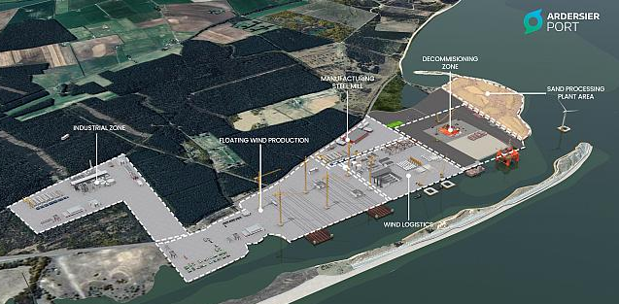
Uniquely positioned to serve the Scottish market
The most advanced floating wind market in the world (up to 14.6GW) with significant EPCI potential targeted by BW Ideol alongside our awarded co-development project
INTOG tenders confirmed for 2022 by Crown Estate Scotland
Agreement with the Ardersier Port for exclusive access for concrete floaters manufacturing
Targeting the set-up of a multi-project construction line with the port owners for industrialization and serial production of floaters

Slide 11

Dual-leg strategy enabling several paths to value creation
Leg
Returns through different cash flow streams
Value profile of floating wind projects
~5 years
3 years
+30 years
Co-EPCI
EPCI margin
Margin realized on EPCI contract value
  Dividends
COD
IRR
Co-Developer
Services agreements
Services provided to SPV including engineering during development (floater design), supervision and management of execution process, and maintenance and monitoring during operations
Royalties
EUR ~15k/MW
Technology royalties
Royalties on floating technologies invoiced to SPV at FID. Typically, around Eur 15k / MW
Project value
FID
Liquidity
On
SPV investment
Selected ownership divestment – full or partial (capital recycling)
Engineering
EUR ~4M
Consenting
Site award
Operations
Cash flow generated from operations as windfarm co-owner
Development
Execution
Operation
Scotwind: signed contracts with Floating Energy Allyance

Slide 12

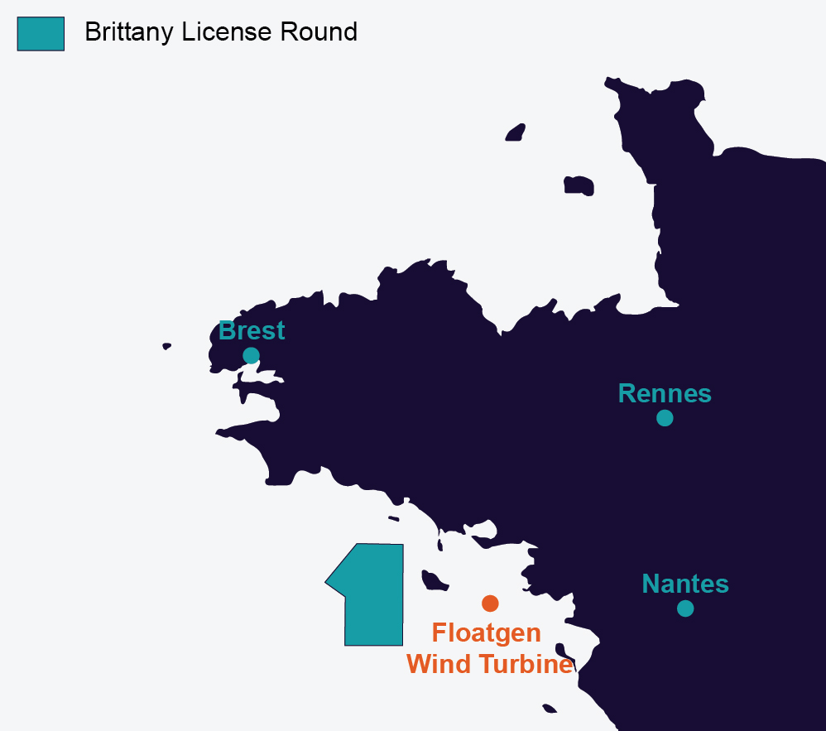


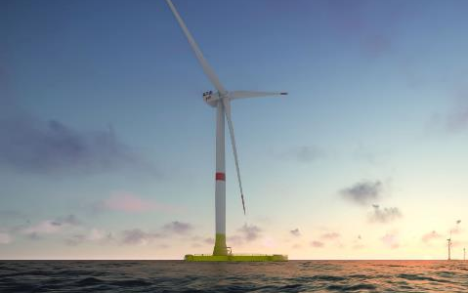


Developing market leadership in France
Partnership agreement with EDF Renewables and Maple Power for the South Brittany Tender (AO5 – up to 270MW)
Cooperation on designing the technical solution for the floating foundations
EDF Renewables is the main offshore wind developer in France – currently developing/building four bottom-fixed projects
Among 10 consortia pre-selected by the French Government in September 2021
Launch of the competitive dialogue in mid-October, Submissions of applications in Q3 2022 and final decision in Q1 2023
Finalisation of the development phase for the EolMed project
30MW (3X10MW – Vestas) floating wind project to be installed off Gruissan in the Mediterranean
Engineering and licence agreements signed in April 2021
5% ownership acquired in December 2022
Progressing toward the Final Investment Decision. Start of construction expected in Q2-2022
Partners
Partners

Slide 13

Advancing the market position in the US and Japan
Proposed wind farm
San Francisco
Vanderberg
Space Force Base
Los Angeles
  BOEM¹ in Q4 announced plan for up to 7 new leasing rounds by 2025 including potentially four large floating wind areas (California, Oregon, Maine)
  Progressing 40MW project off Vanderberg Space Force Base with environmental assessment by the CSLC² as next step in permitting
  California State law passed to create an offshore wind framework
  Hired experienced offshore wind developer specialised in the US market in February 2022
BW Ideol has one of the largest floating wind pipeline under development in Japan, with a total of ~2GW
Hired business developer with extensive project development background from January 2022
1) Bureau of Ocean Energy Management
2) California State Land Commission

Slide 14
Financial overview
3

Slide 15
Disciplined cash management
2021 revenue from design and engineering activities in France (EolMed project) and in Japan of EUR 2.3 million
2021 other income reflecting EUR 1.4 million French tax credit
2021 Net Operating Cash Outflow of EUR 5.9 million for the period 15 March – 31 Dec
Team expanded from 55 to 69 employees, including business development capabilities in the US – further hiring will remain marginal in 2022
EUR 51.1 million of net proceeds from private placement ahead of Euronext growth listing in Q1-2021 to support growth
Investment in Strategic Assets:
  Ardersier Port Rights Acquisition – EUR 5.8 million
  5% stake in EOLMED
Other CapEx remain limited, mainly including capitalised R&D expenses and upgrade works on Floatgen Floater
EUR 32.8 million cash position at end of 2021
No short-term cash requirement, but current project pipeline will need additional funding in the next five years

Slide 16
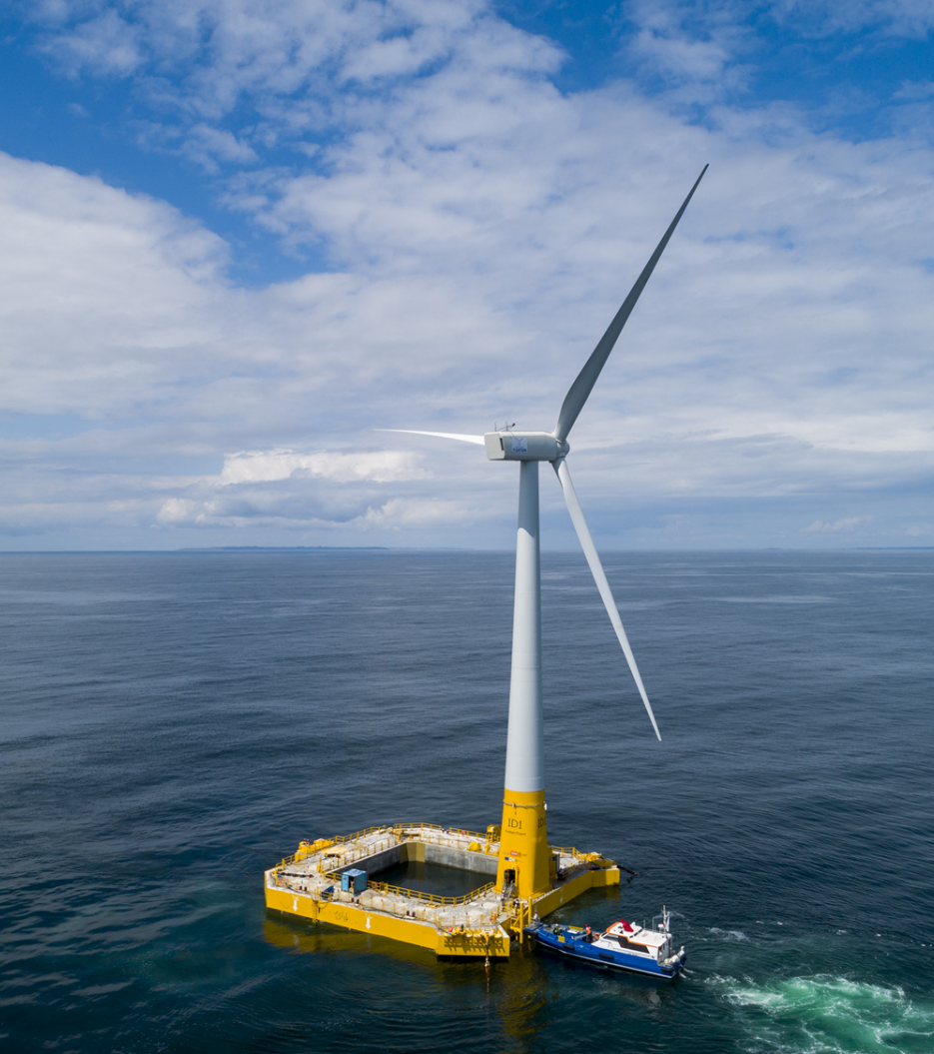


Developing flexible financing capacity
Signed investment agreement with JERA, Japan’s largest utility company, and ADEME Investissement,
a French State-owned investment company in January 2022
Joint investment company for financing the co-development of offshore wind projects using BW Ideol’s patented Damping Pool® technology over the next 5 years
BW Ideol to hold 51% of the new entity
Based on long-term relationships with both parties, with ADEME being a financing partner of the Floatgen and EolMed projects

Slide 17
Summary and outlook
4

Slide 18
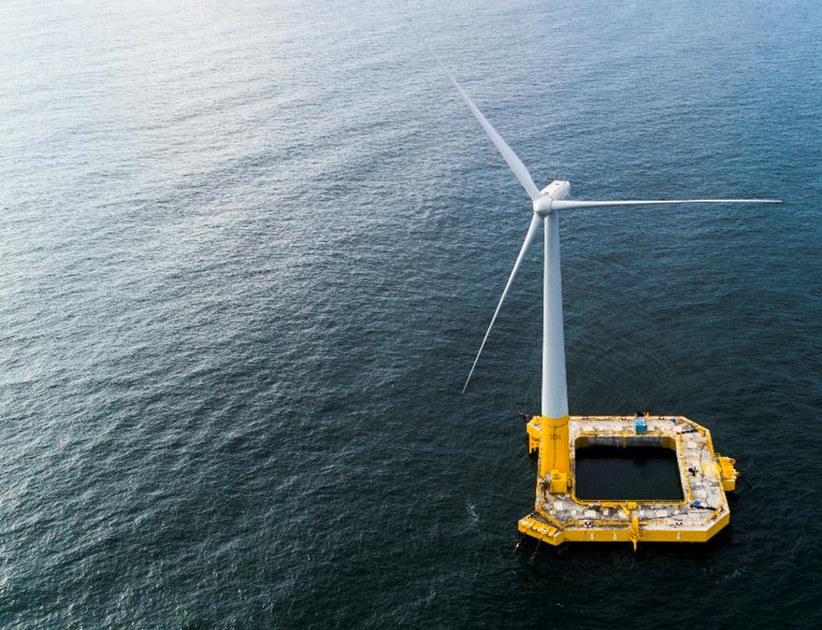
Ahead of plan for reaching our 2030 ambition
Opportunity pipeline before 2024 = tenders announced by Governments with timing and capacity
  France AO6 and AO9, Celtic Sea, Scotland INTOG, California, Norway, Oregon, Maine, Spain
Substantiated pipeline = projects with agreements signed by BW Ideol for a specific site or tender with leading partners
  France AO5, Taiwan, Japan
11.6GW
Opportunity pipeline
1GW
2.2GW
Substantiated pipeline
2021
2024
2030
Ambition

Slide 19








A large and unique project portfolio
California
Existing portfolio
Floatgen 2MW
EolMed 30MW
Partnership with EDF and Maple Power for Brittany tender (250MW)
Existing portfolio
Hibiki 3MW
JDAs sign for a total of up to 2GW
Existing portfolio
ScotWind 1GW
Exclusive partnership with Port of Ardersier
Existing portfolio
Vandenberg Airforce Base 40MW
Existing portfolio
Service agreement with partner in Taiwan
Other agreements in progress
  ~10.0 GW
  ~5.0 GW
  ~2.7 GW
  ~3.0 GW
  ~3.0 GW
  2030 pipeline
  2030 pipeline
  2030 pipeline
  2030 pipeline
  2030 pipeline
Key markets
JDA: Joint development agreement

Slide 20


Several other project opportunities identified and monitored
Other attractive markets
Norway
South Korea
Taiwan
Italy
Spain
General support from government to develop floating wind industry
Government launched new climate plan in Q1 2021
Government confirmed future opening of tender for Sørlige Nordsjø
Absence of offshore wind support mechanism
~60GW renewable capacity target by 2030 – of which 13GW could come from offshore wind
Large development ongoing for floating wind around Ulsan area
Service agreement with partner in Taiwan
Round 1&2 dedicated to bottom-fixed for a total of 5.5GW
Targeting projects in Round 3 (tender in 2023)
Complex soil conditions + local content obligations favor floating wind
Expected to install 1GW of offshore wind per annum
HoT with undisclosed partner in Italy for c. 1GW project
Open market not subject to tendering auction, creating several opportunities
Underlying good conditions for floating, including around Sicilia and Sardaigna
New offshore wind law in preparation by the central government
Several local initiatives to promote offshore wind, in particular in Canaria, Galicia
Offshore wind test sites in operation in Canaria and Basque country
First tenders expected in 2023-24

Slide 21
Outlook
1GW ScotWind award: a strong validation of the Damping Pool technology with cost-efficient concrete floaters and co-developer strategy and benefits
Progressing towards key milestones on South Brittany tender, EolMed and California pilot-project in coming months
Preparing for upcoming tenders in target markets
Focus on cost and capex discipline while developing funding capacity
On track for 2030 goal of engaging in approximately 10GW gross portfolio and ambition of being a leading long-term owner of floating wind assets worldwide

Slide 22
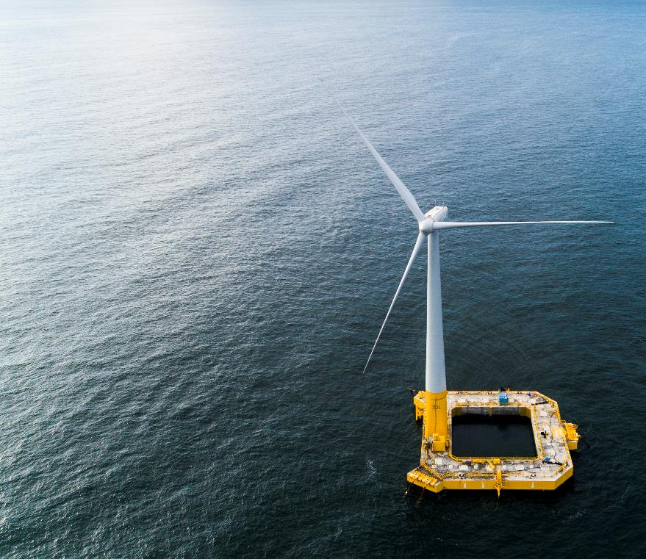
A floating offshore wind champion
Proven floating wind technology
with a strong competitive edge
BW Ideol growth ambition
  Operational
  Development / construction
  ~10GW
Strong pipeline of projects across France, Japan, the UK, the US in partnerships with world class players
Early mover position in the most attractive markets for floating wind, delivering results on first commercial tenders
Extensive track-record of complex industrial offshore projects
  Current
  2030

Slide 23
Q&A

Slide 24
Appendix

Slide 25
Income statement
 | K EUROS
 | For the period 22 October 2020 to 31 December 2021
Revenue from Contracts with Customers | 2 259
Other operating income | 1 402
Operating expenses | (11 424)
Operating profit /(loss) before depreciation/amortisation | (7 763)
Depreciation | (5 566)
Amortisation | (3 251)
Operating profit/(loss) | (16 581)
Net Interest expense | (229)
Other financial items | (519)
Net financial income/(expense) | (748)
Profit/(loss) before tax | (17 329)
Income tax expense | 693
Profit/(loss) from continuing operations | (16 636)
Profit/(loss) from discontinued operation | 0
Net profit/(loss) for the period | (16 636)

Slide 26
Balance sheet
 | K EUROS
ASSETS | For the Period Ending 31 December 2021
Other Property, plant & equipment | 154
Right-of-use assets | 5 344
Technical Installations | 11 852
Other Intangible assets | 4 063
Goodwill | 25 267
Technology Asset | 56 604
Other non-current assets | 3 270
Total non-current assets | 106 553
Trade receivables and other current assets | 3 200
Cash and cash equivalents | 32 792
Total current assets | 35 992
TOTAL ASSETS | 142 545
 | K EUROS
EQUITY AND LIABILITIES | For the Period Ending 31 December 2021
Share Capital | 313
Share Premium | 130 591
Retained Earnings | (17 300)
Foreign Currency Translation Reserve | (2)
Total equity | 113 602
Interest-bearing long-term debt | 5 654
Pension obligations | 229
Asset retirement obligations | 2 172
Other long-term liabilities | 3 539
Long-term lease liabilities | 16
Deferred Tax Liability | 12 453
Total non-current liabilities | 24 063
Trade payables and other short-term liabilities | 3 405
Interest-bearing short-term debt | 1 408
Short-term lease liabilities | 62
Income tax liabilities | 6
Total current liabilities | 4 880
Total liabilities | 28 943
TOTAL EQUITY AND LIABILITIES | 142 545

Slide 27
Cash flow statement
 | KEUROS
 | For the period 22 October 2020 to 31 December 2021
Profit/(loss) before taxes | (17 329)
Unrealised currency exchange loss/(gain) | 2
Depreciation and amortisation | 8 818
Share-based payment expense | 1 812
Change in Subsidies & Grants Receivable | 825
Add back of net interest expense | 229
Changes in working capital | (241)
Net cash flow from operating activities | (5 884)
Investment in other property, plant & equipment | (1 815)
Investments in financial investments | (2 854)
Investment in subsidiaries, net of cash acquired | (49 577)
Net cash flow from investing activities | (54 246)
Proceeds from Share Issuances | 103 796
Transaction Costs Relating to the Share Issuance | (2 298)
Repayment of debt and other liabilities | (2 264)
Interest paid | (438)
Payment of lease liabilities | (5 878)
Net cash flow from financing activities | 92 918
Net change in cash and cash equivalents | 32 788
Cash and cash equivalents at beginning of period | 4
Cash and cash equivalents at end of period | 32 792

