Slide 1
JSC “Latvijas Gāze”
Webinar
Riga, 25 November 2021

Slide 2
AGENDA
Gas market
JSC “Latvijas Gāze” group results
    2.1. Sales and trading segment results
    2.2. Distribution segment results

Slide 3

Gas market

Slide 4
Global gas market
New records, but price peak has probably passed

Slide 5
Global gas market
Europe failed to bring natural gas inventories to five-year average level by start of winter season
Unplanned maintenance on supply side
Carbon Emission Allowances (EUA) futures supported natural gas price rally
Global energy resource deficit pushed some countries to procure gas and coal «at any cost» that lead to price spike
Although winter price 2021/2022 is still subject mainly to:
Weather
Demand destruction on the back of high price environment
Geopolitical tension

Slide 6
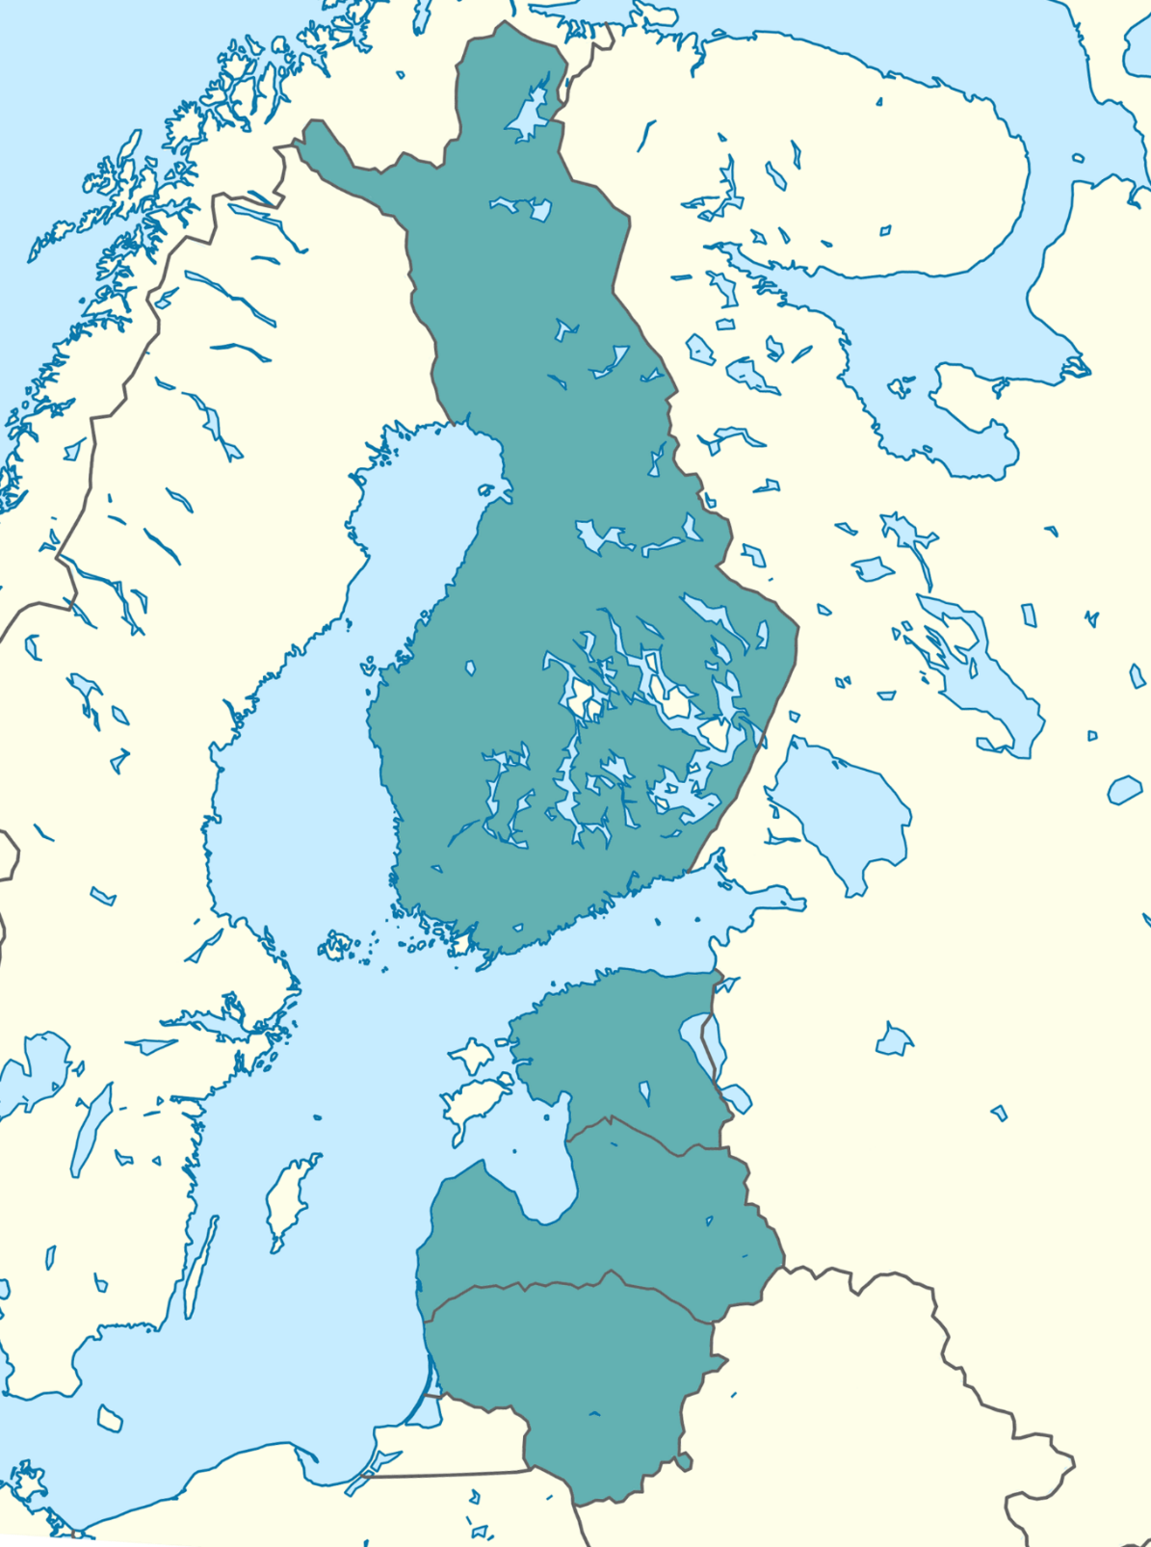
Regional gas market
COMMODITIES ARE CYCLICAL IN NATURE
High gas prices
Increased gas price volatility
Thin margins
In the medium term gas sales industry will be consolidated around big trading companies both in Europe and Baltics
Market acknowledged that aggressive pricing in order to gain market share is not a sustainable strategy
Expected reasonable margins on the back of lower commodity price in 2022

Slide 7
2. JSC “Latvijas Gāze” group results

Slide 8
Group`s key financial figures
Higher sales price
Higher sales volumes
Higher utilization of distribution network
Net profit is negatively impacted by marked-to-market loss of derivatives that are related to future period – winter season
¹Gross profit= Revenue from contracts with customers - Raw materials and consumables used
²JSC “Latvijas Gāze” measures derivatives at fair value and doesn’t implement hedge accounting

Slide 9
2.1 Sales and trading segment results

Slide 10
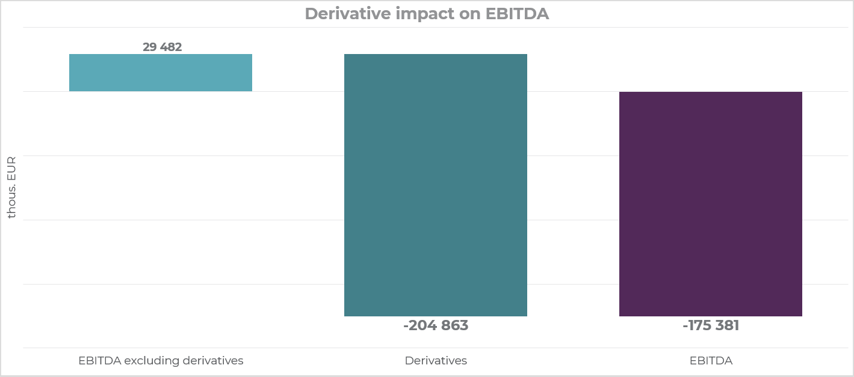
Sales and trading segment key figures
26%
Cold and prolonged winter increased gas consumption in the region
EBITDA is impacted by marked-to-market loss of derivatives that are related to index-linked gas sales contracts in future periods
The financial derivatives are accounted at fair value
Negative impact from derivatives will be compensated by higher gross profit in future periods once underlying inventory will be sold.

Slide 11
Sales and trading segment model
Sales and trading segment classic model is to inject considerable amount of gas during summer season and sell it in winter.
JSC “Latvijas Gāze” uses financial derivatives to manage market (natural gas price) risk.
According to standard accounting policy, JSC “Latvijas Gāze” recognizes marked-to-market value of derivatives every month.

Slide 12
Sales and trading segment- Derivative impact
9 months result shows only part of equation (negative one)
Revenue from gas sales contracts
Underlying hedge asset – inventory will be depleted
Q4 2021 and Q1 2022 - winter
9 months 2021
Derivative marked-to-market loss on the back of price spike
Natural gas sales contracts that were hedged will mostly be recognized in winter
In contrast to derivatives, inventory is not revaluated based on market price. Book value is based on purchase price.

Slide 13
Sales and trading segment- Derivative impact
9 months result shows only part of equation (negative one)
Revenue from gas sales contracts
Underlying hedge asset – inventory will be depleted
Q4 2021 and Q1 2022 - winter
9 months 2021
Derivative marked-to-market loss on the back of price spike
As result of record price spike revenue and cost recognition mismatch has a significant impact on financial statement representation
Natural gas sales contract that were hedged will mostly be recognized in winter
In contrast to derivatives inventory is not revaluated based on market price. Book value is based on purchase price.

Slide 14
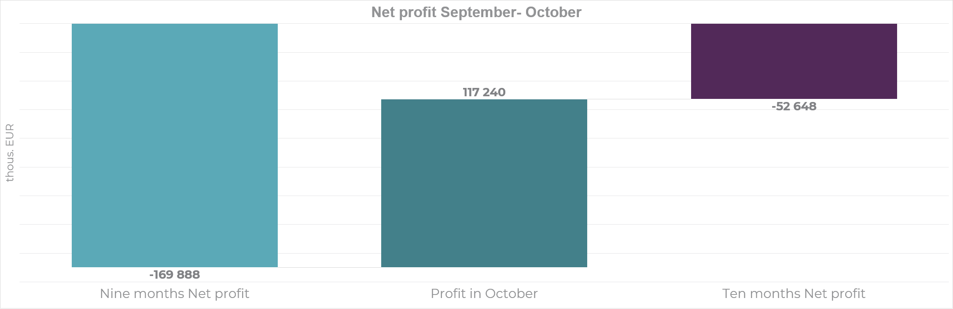
Company – future outlook
Negative result for 9 months will be balanced with company results by end of withdrawal season

Slide 15
2.2 Distribution segment results

Slide 16
Distribution segment key financial figures
10%
35%
49 km
Distribution segment is regulated by the Public Utilities Commission
Harsh and prolonged winter increased utilization of distribution network
Continued to develop a safe and available natural gas distribution infrastructure, with major investments made in construction and reconstruction of gas pipelines

Slide 17


lg.lv
latvijasgaze.ee
latvijasgaze.fi
Aristida Briāna iela 6, Rīga, LV-1001
+371 67 869 866

