Slide 1
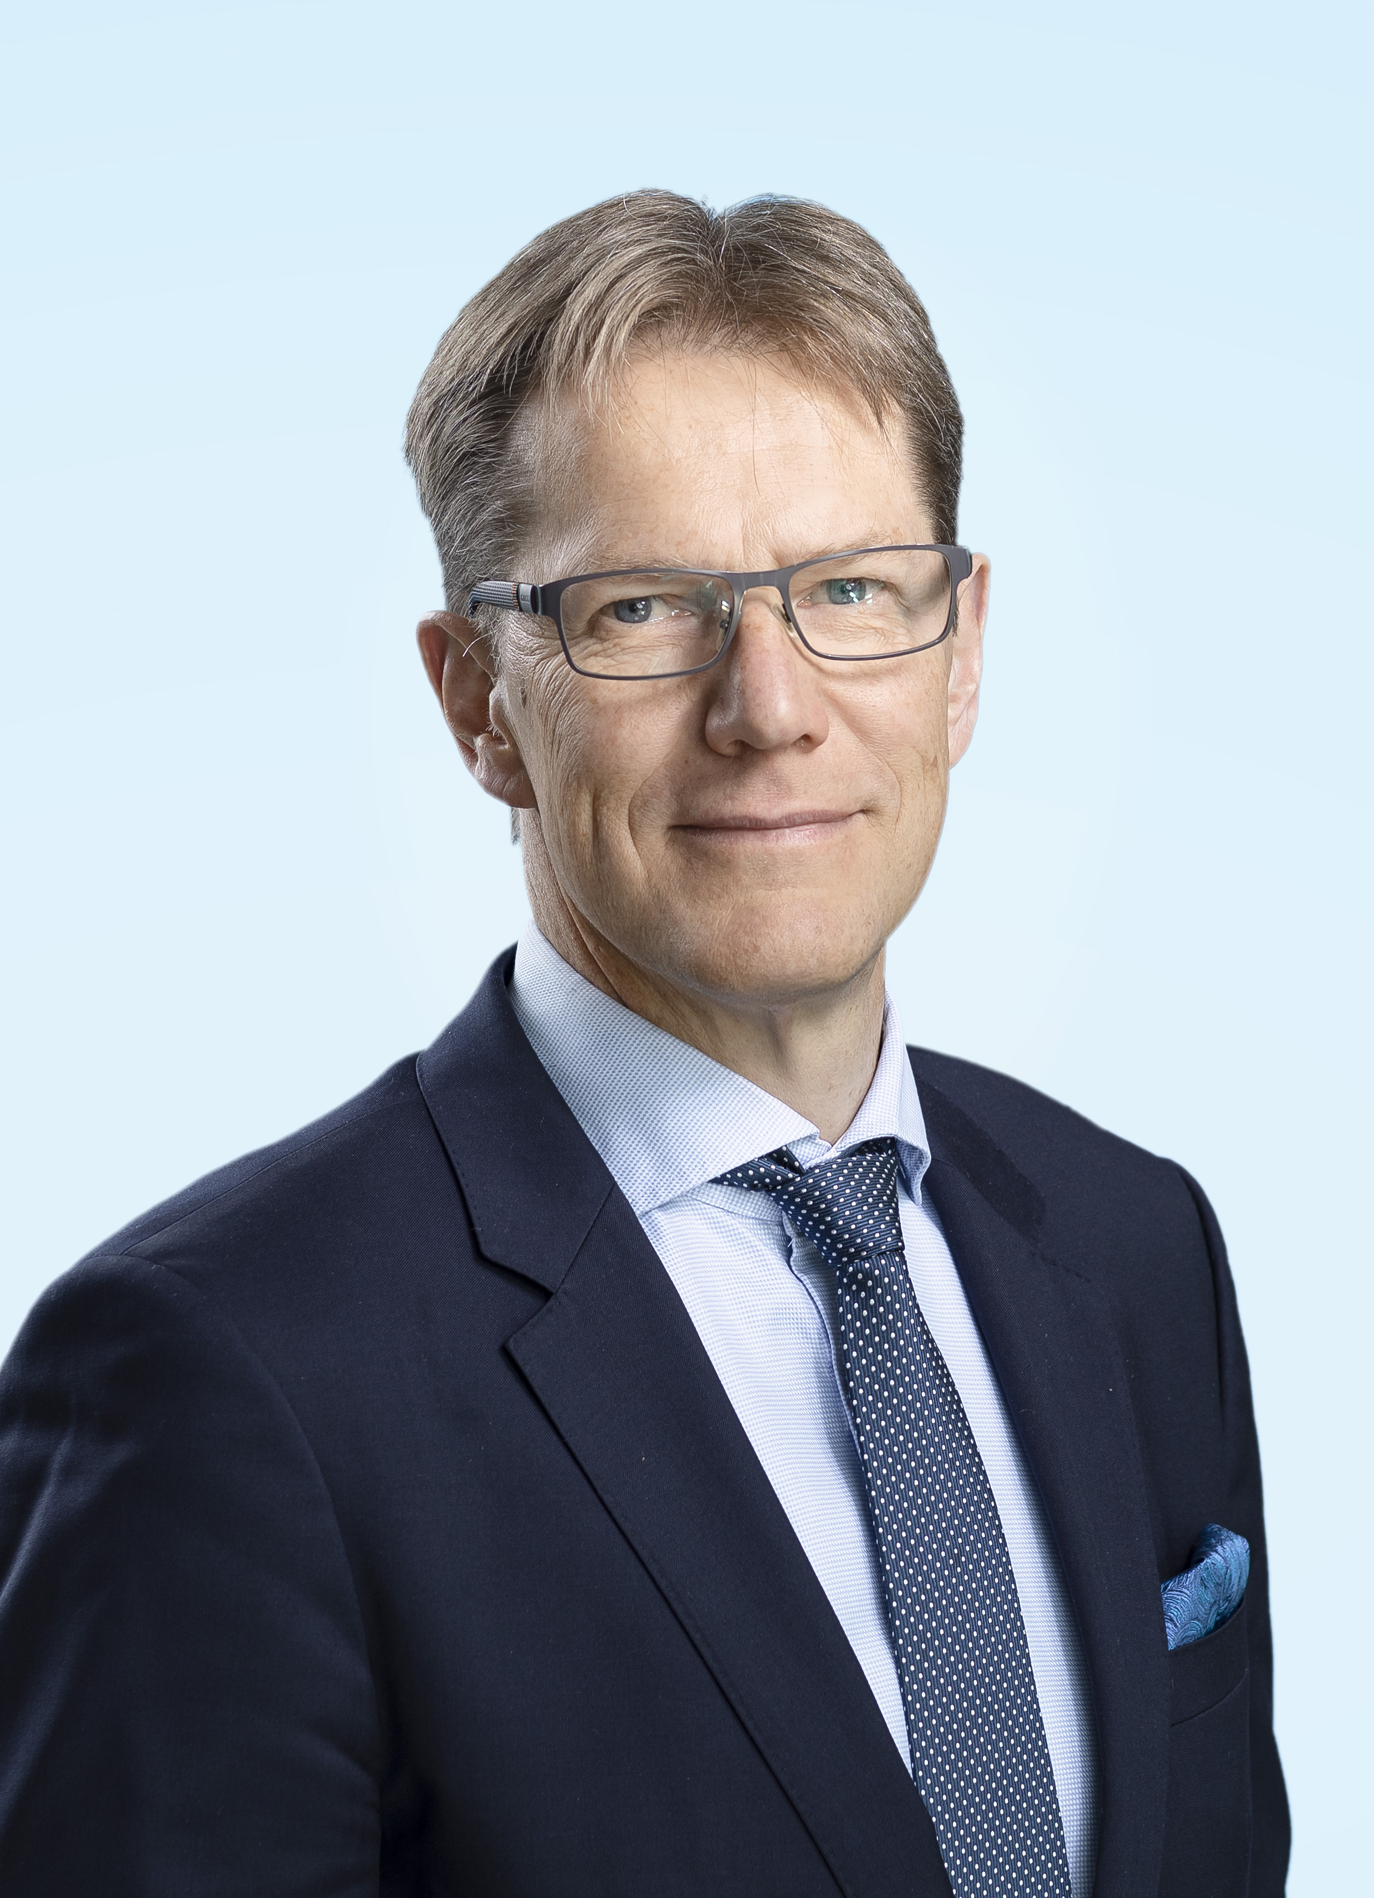
PETRI CASTRéN
Syntynyt 1962
TYÖKOKEMUS:
Kemira Oyj
2013 – Talousjohtaja
Nokia Siemens Networks, 2008 – 2013 Head of Corporate Finance (Group Treasurer) 2007 – 2008 Head of Corporate Development
Nokia Oyj 2006 – 2007 Vice President, Nokia NSN negotiation team lead and Head of Transition program Nokia Networks
2005 – 2006 Vice President, Managed Services Engagement Team
Nokia Oyj
1999 – 2005 VP & Head of Mergers & Acquisitions Finland
KOULUTUS:
1988 Helsingin Yliopisto, Oikeustieteen maisteri (OTM)
1996 University of Connecticut, Executive MBA Program, Master of Business Administration, Stamford, CT, USA

