Slide 1
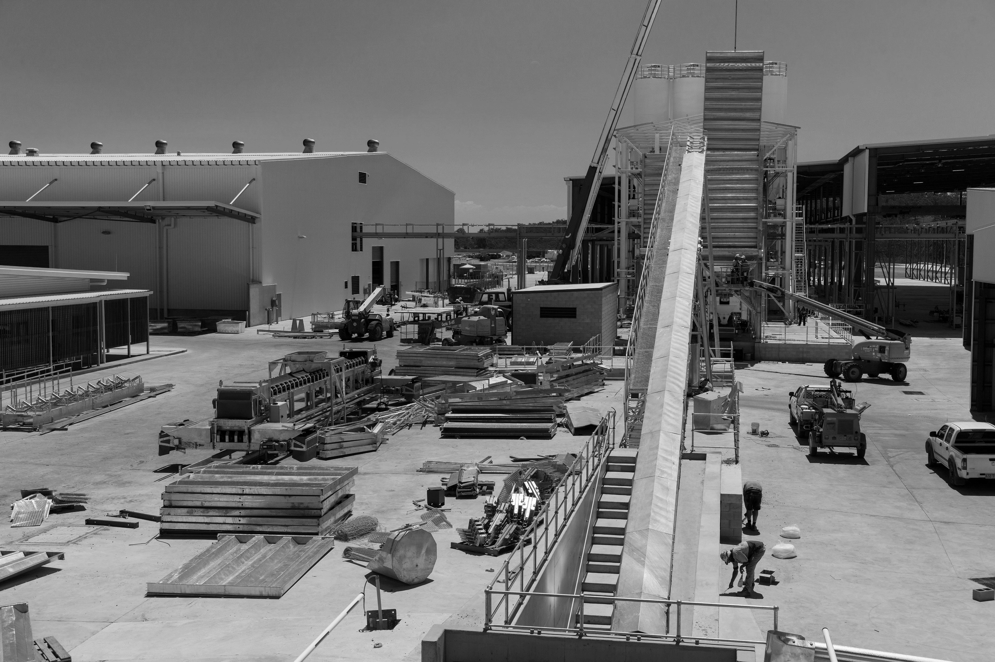
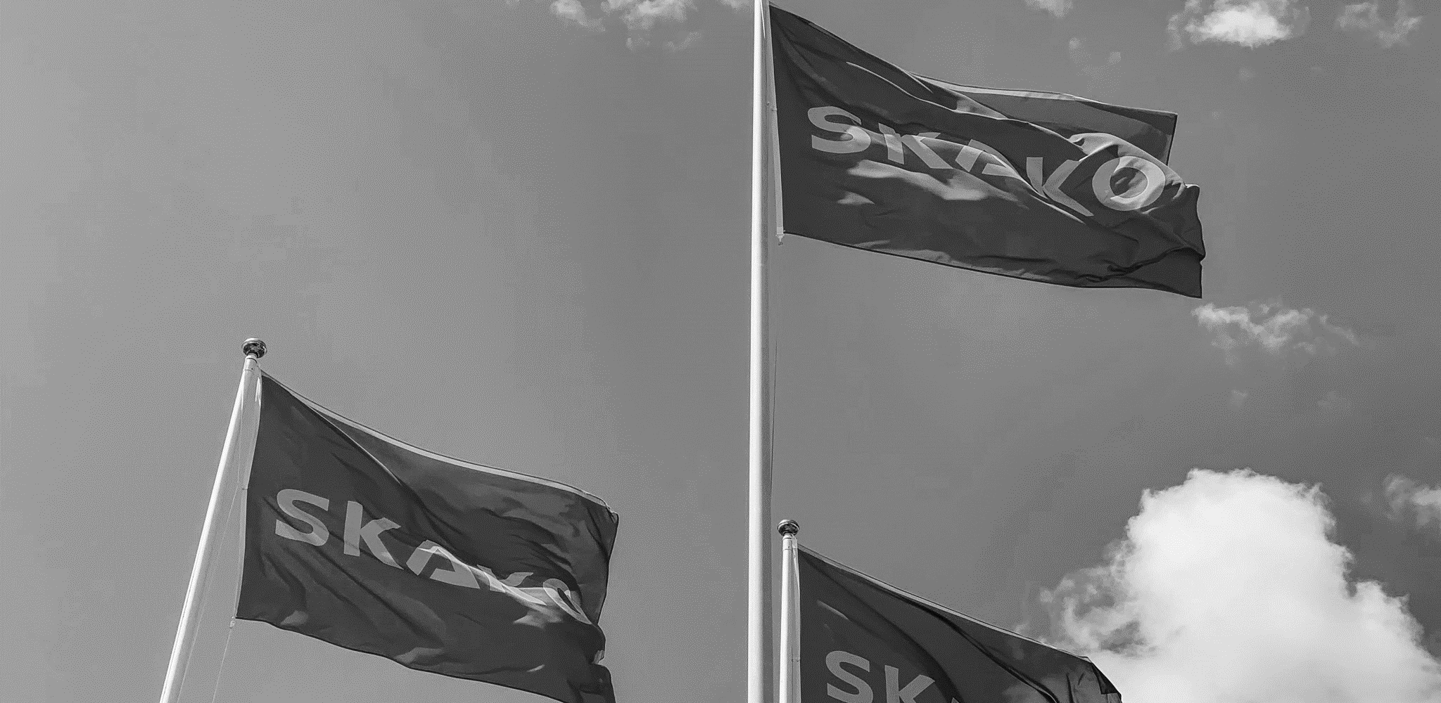
2023
^{Accounting period:}
^{1. January – 30. June 2023}
INTERIM REPORT Q2
^{Revenue} ^{(DKKm)}
H1: 252.1 (+24.4%) Q2: 122.8 (+15.2%)
^{EBIT before special items} ^{(DKKm)}
H1: 17.5 (+62.0%) Q2: 9.7 (+84.2%)
EBIT margin before special items
H1: 7.0% (+1.7pp) Q2: 7.9% (+2.9pp)
^{ROIC}
H1: 16.9% (+5.8pp)
^{Order backlog} ^{(DKKm)}
H1: 212.4 (+1.4%)
SKAKO A/S
CVR: 36440414
Bygmestervej 2
5600 Faaborg
Denmark

Slide 2
CONTENTS
1 Q2 2023 IN BRIEF 3
2 KEY FIGURES AND FINANCIAL RATIOS 4
3 FINANCIAL REVIEW Q2 2023 8
4 SKAKO CONCRETE 14
5 SKAKO VIBRATION 18
6 FINANCIAL STATEMENTS 22
6.1 STATEMENT BY MANAGEMENT 23
6.2 CONSOLIDATED INCOME STATEMENT 24
6.3 CONSOLIDATED STATEMENT OF COMPREHENSIVE INCOME 25
6.4 CONSOLIDATED BALANCE SHEET 30 JUNE 26
6.5 CONSOLIDATED CASH FLOW STATEMENT 28
6.6 CONSOLIDATED STATEMENT OF CHANGES IN EQUITY 29
6.7 Segment information 31
6.8 QUARTERLY KEY FIGURES AND FINANCIAL RATIOS 33
^{Quarterly report 2023}
Important notice about this document
This document contains forward-looking statements. Words such as believe, expect, may, will, plan, strategy, prospect, foresee, estimate, project, anticipate, can, intend, outlook, guidance, target and other words and terms of similar meaning in connection with any discussion of future operation of financial performance identify forward-looking statements. Statements regarding the future are subject to risks and uncertainties that may result in considerable deviations from the outlookset forth. Furthermore, some of these expectations are based on assumptions regarding future events which may prove incorrect
^{Page 2}

Slide 3
1. Q2 2023 IN BRIEF
^{Quarterly report 2023}
SKAKO Concrete
SKAKO Vibration
Plant sales
After sales
62.8 (mDKK)
EBIT margin 6.1%
61.6 (mDKK)
EBIT margin 11.0%
80.1 (mDKK)
42.7 (mDKK)
Revenue split by
Concrete & Vibration
Revenue split
by plant sales
and aftersales
^{Order intake} ^{(DKKm)} | ^{Order backlog} ^{(DKKm)} | ^{Revenue} ^{(DKKm)} | ^{EBIT before special items} ^{(DKKm)} | ^{EBIT margin} ^{before special items} | ^{Earnings per share} ^{(DKKm)} | ^{Employees} | ^{ROIC}
132.6 (-18.7%) | 212.4 (+1.4%) | 122.8 (+15.2%) | 9.7 (+84.2%) | 7.9% (+2.9pp) | 1.97 (+1.25) | 208 (+1.5%) | 16.9% (+5.8pp)
^{Down from 163.2 in Q2 2022} | ^{Up from 209.6 in Q2 2022} | ^{Up from 106.6 in Q2 2022} | ^{Up from 5.3 in Q2 2022} | ^{Up from 5.0% in Q2 2022} | ^{Up from 0.72 in Q2 2022} | ^{Up from 205 in Q2 2022} | ^{Up from 11.1% in Q2 2022}
^{Page 3}

Slide 4
2. KEY FIGURES AND FINANCIAL RATIOS
DKK thousands | Q2 2023 | Q2 2022 | H1 2023 | H1 2022 | FY 2022
INCOME STATEMENT
Revenue | 122,774 | 106,584 | 252,134 | 202,601 | 437,920
Gross profit | 30,606 | 26,334 | 59,400 | 51,663 | 114,637
Operating profit (EBIT) before special items | 9,707 | 5,270 | 17,535 | 10,825 | 30,842
Special items | - | (1,650) | (1,934) | (1,650) | (1,650)
Operating profit (EBIT) after special items | 9,707 | 3,620 | 15,601 | 9,175 | 29,192
Net financial items | (1,541) | (1,266) | (2,575) | (1,738) | (4,962)
Profit before tax | 8,166 | 2,354 | 13,026 | 7,437 | 24,230
Profit for the year | 6,088 | 2,222 | 9,462 | 5,838 | 25,074
BALANCE SHEET
Non-current assets | 95,510 | 79,865 | 95,510 | 79,865 | 88,599
Current assets | 318,369 | 246,078 | 318,369 | 246,078 | 295,458
Assets | 413,879 | 325,943 | 413,879 | 325,943 | 384,057
Equity | 142,565 | 127,923 | 142,565 | 127,923 | 146,167
Non-current liabilities | 28,733 | 30,056 | 28,733 | 30,056 | 26,473
Current liabilities | 242,581 | 167,965 | 242,581 | 167,965 | 211,417
Net debt | 57,619 | 30,171 | 57,619 | 30,171 | 20,997
Net working capital | 140,280 | 106,488 | 140,280 | 106,488 | 110,681
OTHER KEY FIGURES
Investment in intangible assets | 47 | 1,238 | 80 | 1,473 | 4,153
Investment in tangible assets | 2,881 | 540 | 9,707 | 1,005 | 3,179
Cash flow from operating activities (CFFO) | (15,327) | 10,542 | (10,445) | 10,432 | 28,850
Free cash flow | (18,255) | 8,763 | (20,232) | 7,953 | 20,183
Average number of employees | 208 | 205 | 208 | 205 | 205

Slide 5
KEY FIGURES AND FINANCIAL RATIOS CONTINUED
DKK thousands | Q2 2023 | Q2 2022 | H1 2023 | H1 2022 | FY 2022
FINANCIAL RATIOS
Gross profit margin | 24.9% | 24.7% | 23.6% | 25.5% | 26.2%
Profit margin (EBIT margin) before special items | 7.9% | 5.0% | 7.0% | 5.3% | 7.0%
Profit margin (EBIT margin) after special items | 7.9% | 3.4% | 6.2% | 4.5% | 6.7%
Liquidity ratio | 131.2% | 145.6% | 131.2% | 145.6% | 140.1%
Equity ratio | 34.4% | 39.0% | 34.4% | 39.0% | 38.3%
Return on equity | 21.2% | 10.6% | 21.2% | 10.6% | 17.9%
ROIC | 16.9% | 11.1% | 16.9% | 11.1% | 16.5%
Financial leverage | 40.4% | 24.2% | 40.4% | 24.2% | 14.2%
Net debt to EBITDA | 1.3 | 1.1 | 1.3 | 1.1 | 0.5
NWC/Revenue | 28.8% | 27.3% | 28.8% | 27.3% | 25.3%
Earnings per share | 1.97 | 0.72 | 3.07 | 1.89 | 8.13
Equity value per share | 46.2 | 41.5 | 46.2 | 41.5 | 48.0
Share price | 73.5 | 55.0 | 73.5 | 55.0 | 62.6
Price-book ratio | 1.6 | 1.3 | 1.6 | 1.3 | 1.3
Market capitalization | 228,322 | 170,853 | 228,322 | 170,853 | 194,461
Order backlog | 212,433 | 209,582 | 212,433 | 209,582 | 215,202
For calculation of financial ratios please see page 35. Net working capital is calculated as inventory, trade receivables and contract assets less contract liabilities and trade payables. Backlog represents revenue from signed contracts or orders executed but not yet completed or performed in full.
^{Page 5}

Slide 6
KEY FIGURES AND FINANCIAL RATIOS – EUR
EUR thousands | Q2 2023 | Q2 2022 | H1 2023 | H1 2022 | FY 2022
INCOME STATEMENT
Revenue | 16,488 | 14,326 | 33,860 | 27,231 | 58,883
Gross profit | 4,110 | 3,539 | 7,977 | 6,944 | 15,414
Operating profit (EBIT) before special items | 1,304 | 708 | 2,355 | 1,455 | 4,147
Special items | - | (222) | (260) | (222) | (222)
Operating profit (EBIT) after special items | 1,304 | 487 | 2,095 | 1,233 | 3,925
Net financial items | (207) | (170) | (346) | (234) | (667)
Profit before tax | 1,097 | 316 | 1,749 | 1,000 | 3,258
Profit for the year | 818 | 299 | 1,271 | 785 | 3,371
BALANCE SHEET
Non-current assets | 12,824 | 10,735 | 12,824 | 10,735 | 11,913
Current assets | 42,748 | 33,075 | 42,748 | 33,075 | 39,728
Assets | 55,572 | 43,810 | 55,572 | 43,810 | 51,640
Equity | 19,142 | 17,194 | 19,142 | 17,194 | 19,654
Non-current liabilities | 3,858 | 4,040 | 3,858 | 4,040 | 3,560
Current liabilities | 32,572 | 22,576 | 32,572 | 22,576 | 28,430
Net debt | 7,737 | 4,055 | 7,737 | 4,055 | 2,824
Net working capital | 18,836 | 14,313 | 18,836 | 14,313 | 14,884
OTHER KEY FIGURES
Investment in intangible assets | 6 | 198 | 11 | 198 | 558
Investment in tangible assets | 387 | 41 | 1,303 | 135 | 427
Cash flow from operating activities (CFFO) | (2,058) | 1,417 | (1,402) | 1,420 | 3,879
Free cash flow | (2,451) | 1,178 | (2,717) | 1,087 | 2,714
Average number of employees | 208 | 205 | 208 | 205 | 205

Slide 7
KEY FIGURES AND FINANCIAL RATIOS – EUR CONTINUED
EUR thousands | Q2 2023 | Q2 2022 | H1 2023 | H1 2022 | FY 2022
FINANCIAL RATIOS
Gross profit margin | 24.9% | 24.7% | 23.6% | 25.5% | 26.2%
Profit margin (EBIT margin) before special items | 7.9% | 5.0% | 7.0% | 5.3% | 7.0%
Profit margin (EBIT margin) afer special items | 7.9% | 3.4% | 6.2% | 4.5% | 6.7%
Liquidity ratio | 131.2% | 145.6% | 131.2% | 145.6% | 140.1%
Equity ratio | 34.4% | 39.0% | 34.4% | 39.0% | 38.3%
Return on equity | 21.2% | 10.6% | 21.2% | 10.6% | 17.9%
ROIC | 16.9% | 11.1% | 16.9% | 11.1% | 16.5%
Financial leverage | 40.4% | 24.2% | 40.4% | 24.2% | 14.2%
Net debt to EBITDA | 1.3 | 1.1 | 1.3 | 1.1 | 0.5
NWC/Revenue | 28.8% | 27.3% | 28.8% | 27.3% | 25.3%
Earnings per share | 0.27 | 0.10 | 0.41 | 0.25 | 1.09
Equity value per share | 6.21 | 5.58 | 6.21 | 5.58 | 6.45
Share price | 9.87 | 7.39 | 9.87 | 7.39 | 8.42
Price-book ratio | 1.59 | 1.33 | 1.59 | 1.33 | 1.3
Market capitalization | 30,657 | 22,964 | 30,657 | 22,964 | 26,150
Order backlog | 28,524 | 28,170 | 28,524 | 28,170 | 28,939

Slide 8
3. FINANCIAL REVIEW Q2 2023
DKK thousands | Q2 2023 | Q2 2022 | Change | H1 2023 | H1 2022 | Change
Plant sales revenue | 80,059 | 62,872 | 27.3% | 165,593 | 117,439 | 41.0%
Aftersales revenue | 42,715 | 43,712 | -2.3% | 86,541 | 85,162 | 1.6%
Total revenue | 122,774 | 106,584 | 15.2% | 252,134 | 202,601 | 24.4%
Production costs | (92,168) | (80,250) | 14.9% | (192,734) | (150,938) | 27.7%
Gross profit | 30, 606 | 26,334 | 16.2% | 59,400 | 51,663 | 15.0%
Gross profit margin | 24.9% | 24.7% | 0.2pp | 23.6% | 25.5% | -1.9pp
Distribution costs | (11,648) | (11,181) | 4.2% | (23,320) | (22,565) | 3.3%
Administrative expenses | (9,251) | (9,882) | -6.4% | (18,545) | (18,272) | 1.5%
Operating profit (EBIT) before special items | 9,707 | 5,270 | 84.2% | 17,535 | 10,826 | 62.0%
Operating profit margin (EBIT margin) before special items | 7.9% | 5.0% | 2.9pp | 7.0% | 5.3% | 1.7pp
Special items | - | (1,650) | NA | (1,934) | (1,650) | 17.2%
Operating profit (EBIT) after special items | 9,707 | 3,620 | 168.1% | 15,601 | 9,175 | 70.0%
Operating profit margin (EBIT margin) after special items | 7.9% | 3.4% | 4.5pp | 6.2% | 4.5% | 1.7pp
Profit for the period | 6,088 | 2,222 | 174.0% | 9,462 | 5,838 | 62.1%
Order backlog beginning of period | 202,608 | 152,985 | 32.4% | 215,202 | 122,309 | 75.9%
Order intake | 132,599 | 163,181 | -18.7% | 249,365 | 289,874 | -14.0%
Revenue | (122,774) | (106,584) | 15.2% | (252,134) | (202,601) | 24.4%
Order backlog end of period | 212,433 | 209,582 | 1.4% | 212,433 | 209,582 | 1.4%

Slide 9
Financial highlight
The markets of SKAKO continue to show high level of activity, in line with what we saw in the second half of 2022.
As expected, SKAKO delivered a strong Q2 with high order intake and improved profitability. The order backlog continues to be at a very high level in both Concrete and Vibration. This gives SKAKO a good outset for delivering strong results in 2023 in accordance with our increased guidance, see company announcement 8/2023. For a detailed financial review of each business unit, please see section 4 for SKAKO Concrete and section 5 for SKAKO Vibration.
Revenue
In Q2 2023 revenue was DKK 122.8m which is an increase of 15.2% compared to the same period in 2022. Revenue from plant orders increased by 27.3%, while revenue from aftersales decreased by 2.3%, compared to Q2, 2022.
Gross profit
Gross profit was DKK 30.6m in Q2 2023 which is an increase of 16.2% compared to Q2 2022, driven by higher revenue. Gross profit margin in Q2 2023 increased by 0.2pp compared to Q2 2022 driven by an increase in gross profit margin in SKAKO Vibration of 2.8pp.
Capacity costs
Despite the high revenue growth capacity costs decreased by DKK 0.2m or 1.0% in Q2 2023 compared to Q2 2022 which was impacted by staff investments to enable future growth.
Operating profit
Operating Profit (EBIT) before special items increased by 84% to DKK 9.7m compared to Q2 2022.
This was driven by the higher revenue and improved EBIT margin of 2.9pp to 7.9% showing the scalability of our business with almost unchanged capacity cost despite high revenue growth.
Net financial items
Net financial items consist of interest income, interest expenses as well as realized and unrealized foreign exchange gains and losses and amount to an expense of DKK 1.5m for the period compared to an expense of DKK 0.5m in Q2 2022.
Profit for the period
Profit after tax amounted to DKK 6.1m in Q2 2023 compared to DKK 2.2 in the same period in 2022.
Order intake and backlog
Order intake in Q2 2023 amounted to DKK 132.6m compared to DKK 163.2m in Q2 in 2022, a decrease of 18.7% due to the very high order intake in Q2 2022. However, the order intake was still maintained at a high level. The order backlog increased by 1.4% end of Q2 2023 and thereby maintained the very high level from previous quarters. The pipeline of new orders remains strong for both SKAKO Vibration and SKAKO Concrete and gives a strong outset for the rest of the year.

Slide 10
Financial highlight
Cash flow developments
Cash flow from operating activities (CFFO) amounted to DKK (15.3)m compared to DKK 10.5m last year. The negative cash flow development in Q2 2023 is due to delay of a few large payments. Most of the payments have been received after 30 June 2023.
Free cash flow amounted to DKK (18.3)m due to the negative operating cash flow and investments in tangible assets to support growth.
Equity
Group equity was DKK 142.6m on 30 June 2023 (DKK 127.9m on 30 June 2022) corresponding to an equity ratio of 34.5% (39.0% on 30 June 2022).
ROIC
As of 30 June 2023, return on invested capital (rolling four quarters) amounted to 16.9% compared to 11.1% as of 30 June 2022. The increase in return on invested capital is due to strong results in the last three quarters compared to the previous quarters.
Balance sheet
As of 30 June 2023, Group’s total assets were DKK 413.9m (30 June 2022: DKK 325.9m) Non-current assets increased by DKK 15.6m and amounted to DKK 95.4m (30 June 2022: DKK 79.9m) while current assets increased by DKK 72.3m to DKK 318.4m (30 March 2022: DKK 246.1m). The increase in current assets relates to increase in trade receivables as well as new rental agreements in France and US together with increase in deferred tax asset following higher profits.
Due to the negative cash flow development net debt increased by DKK 27.4m to DKK 57.6m in Q2 2023. Net debt is expected to decrease again as we have collected most delayed payments described above.
The ratio of net debt to EBITDA amounted to 1.3 compared to 1.1 on 30 June 2022 due to the negative cash flow development and is expected to improve in Q3 2023. It is our ambition to keep the ratio of net debt to EBITDA below 2.5.
Events after the balance sheet date
There have been no events that materially affect the assessment of this interim report after the balance sheet date and up to today.
Outlook 2023
Guidance for 2023 was increased in company announcement 8/2023 and is as follows:
Operating profit (EBIT) before special items is expected to be DKK 36-40m. Special items for 2023 are still expected to amount to DKK 2.0-2.5m related to transaction costs in connection with the terminated transaction process with Zefyr Invest.
Expectations are based on current exchange rates, in particular USD/DKK, remaining at current levels.
The outlook is based on the assumption that no events with a material negative impact on the global economy and SKAKO's markets will occur in the second half of 2023.
Accounting policies as well as financial estimates and assumptions
The interim report has been prepared in accordance with IAS 34, Interim financial reporting, as adopted by the EU and further Danish disclosure requirements in respect of interim reports for listed companies.
The accounting policies used for the interim report are the same as the accounting policies used for Annual Report 2022 to which we refer for a full description. The Group has adopted all new, amended and revised accounting standards and interpretations as published by the IASB and adopted by the EU effective for the accounting period beginning on 1 January 2023. We refer to the notes to the annual report for a description of material estimates and assumptions.
Compared with the description in Annual Report 2022, there have been no changes in the accounting estimates and assumptions made by Management in the preparation of the interim report.

Slide 11
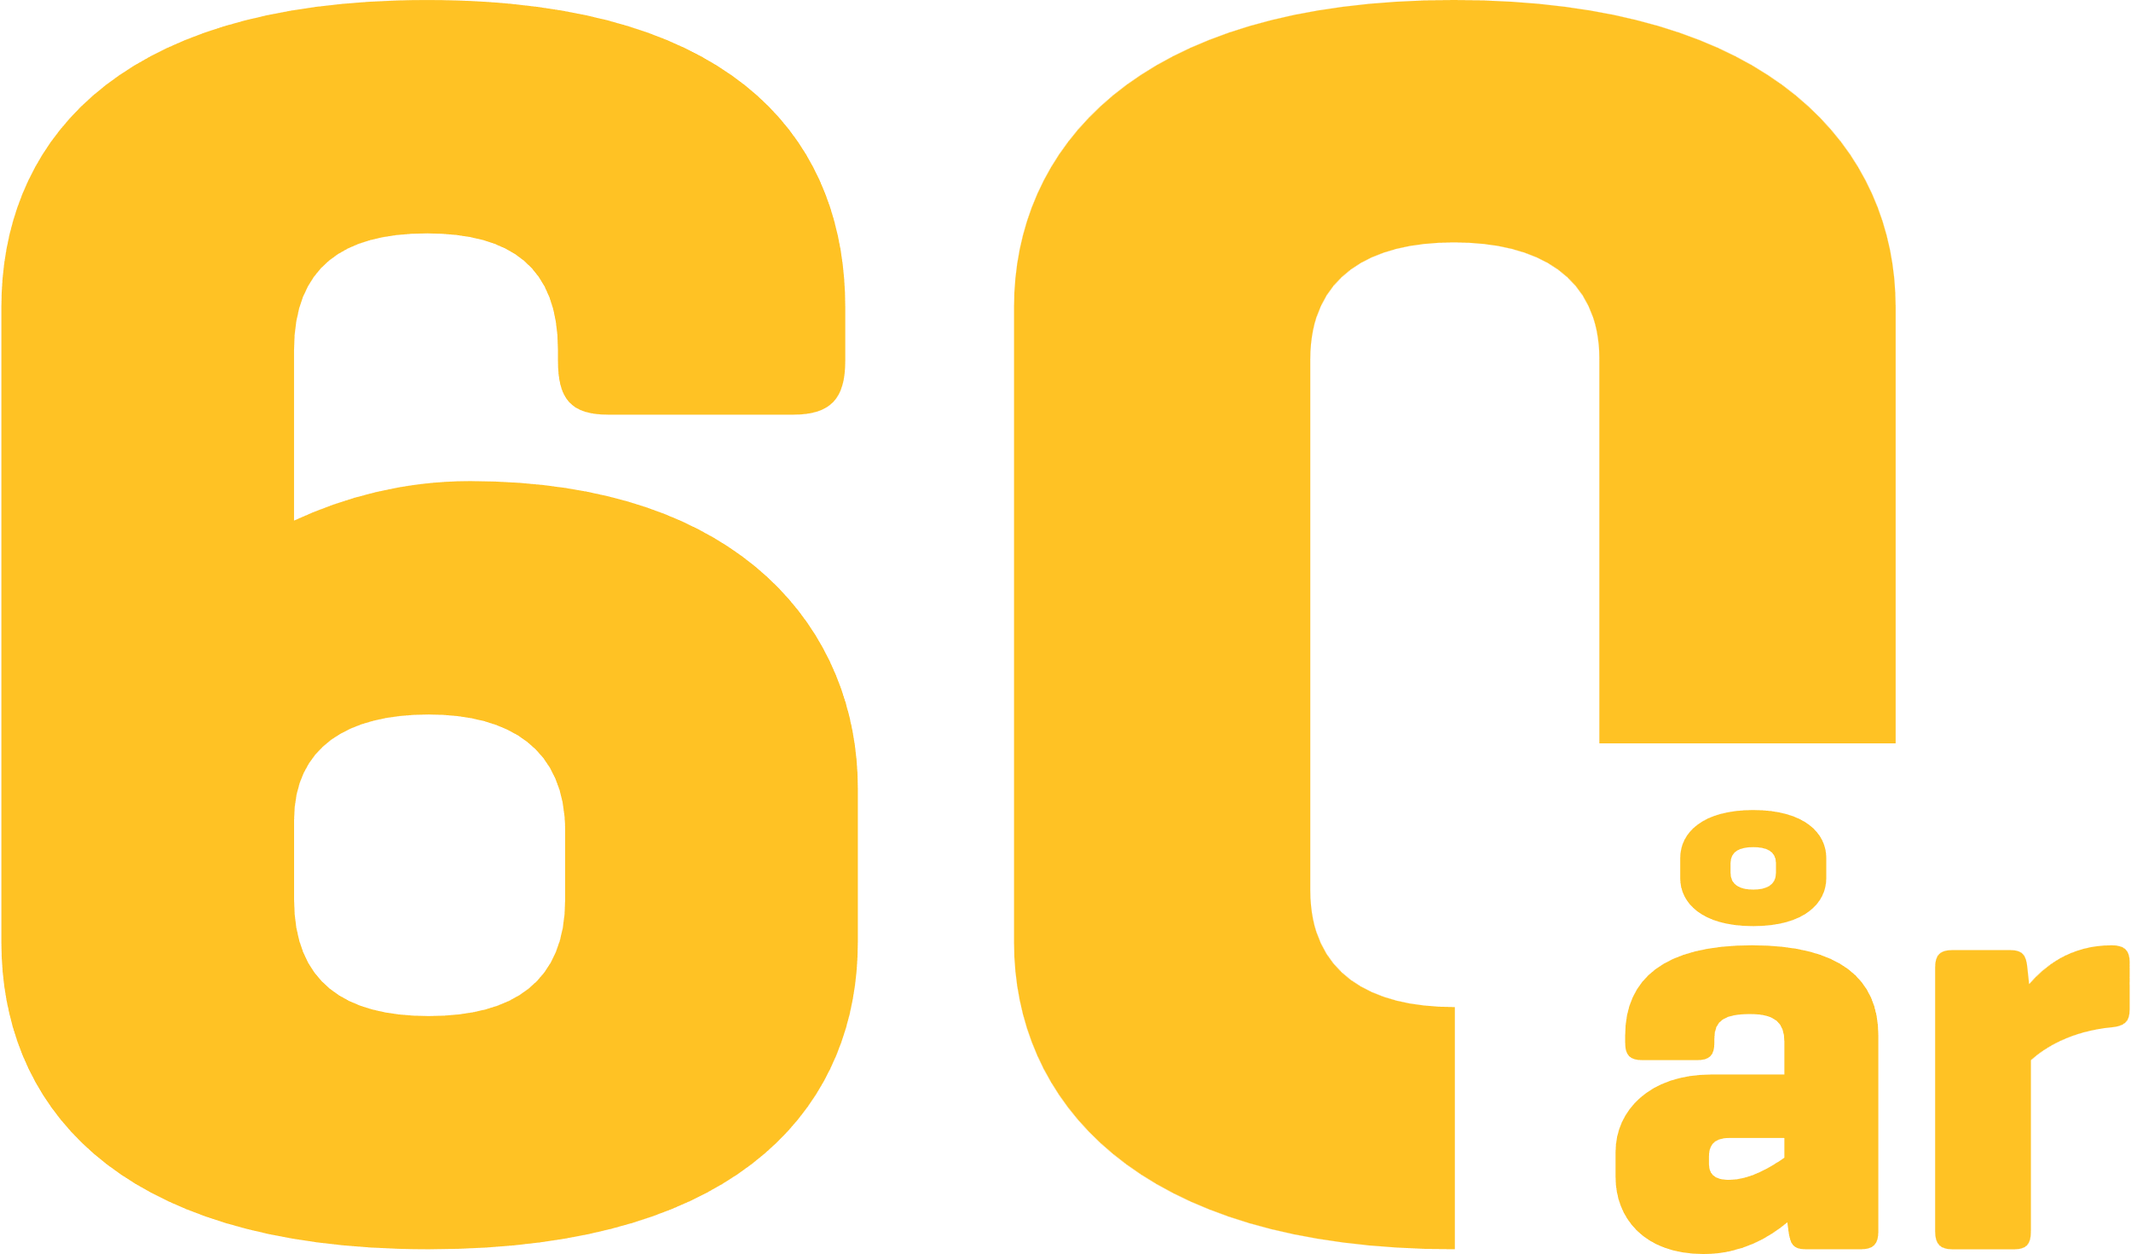
It all began with vibration technology, which paved SKAKO’s way into the concrete industry
Valdemar Skak and Frits Korsgaard in front of the very first SKAKOMAT control system (Valdemar Skak to the left, Frits Korsgaard to the right).
On 1 July 2023, SKAKO had 60-year anniversary. SKAKO was founded by Valdemar Skak (1913-1999) and Frits Korsgaard.
To mark the anniversary, we have interviewed Frits Korsgaard about his memories of SKAKO.
The journey started in Denmark with a new type of vibrator that was applicable in various industries, invented by Valdemar Skak.
“One day, we received an order from a concrete factory which had heard about our vibratory feeders which they believed could be useful for them. They wanted to use the vibratory feeders to proportion sand and stones for their concrete, and in this way, we entered the concrete industry,” says Frits Korsgaard.
Following the order from the concrete factory, Frits Korsgaard had an innovative idea. In the 1960s, most concrete companies mixed the concrete manually. The sand and gravel for the concrete were loaded by hand with shovels, which was a heavy and time-consuming work. Therefore, SKAKO decided to develop the mixing process and launch an automated solution to control the proportioning of aggregates for the concrete – the “SKAKOMAT,” which is still available today in a more advanced and digital version.
From this point, SKAKO started to take off:
“The SKAKOMAT solution quickly became the top-selling product in Denmark. Even today, I can still recall the names of most Danish towns because I visited almost all approx. 400 Danish concrete factories back then,” remembers Frits Korsgaard.
Read more here: 60 years with vibratory equipment, machinery for the concrete industry, quality, and a strong workplace culture - SKAKO A/S

Slide 12
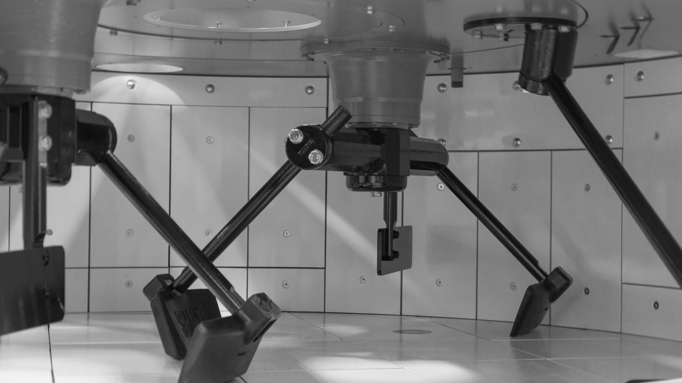
4. SKAKO CONCRETE
^{Quarterly report 2023}
^{Page 12}

Slide 13
Q2 2023 FINANCIAL REVIEW SKAKO CONCRETE
DKK million | Q2 2023 | Q2 2022 | Change | H1 2023 | H1 2022 | Change
Plant sales revenue | 37.0 | 18.7 | 97.9% | 78.9 | 35.8 | 120.4%
Aftersales revenue | 25.8 | 27.9 | -7.5% | 53.0 | 53.1 | -0.2%
Total revenue | 62.8 | 46.7 | 34.5% | 131.9 | 88.9 | 48.4%
Gross profit | 11.8 | 9.8 | 20.4% | 23.1 | 18.7 | 23.5%
Gross profit margin | 18.8% | 21.0% | -2.2pp | 17.6% | 21.0% | -3.4pp
Operating profit (EBIT) | 3.8 | 2.4 | 58.3% | 7.0 | 4.0 | 75.0%
Profit margin (EBIT margin) | 6.1% | 5.1% | 1.0pp | 5.3% | 4.5% | 0.8pp
Order backlog beginning of period | 124.3 | 82.1 | 51.4% | 142.7 | 72.2 | 97.6%
Order intake | 73.5 | 91.8 | -19.9% | 124.2 | 143.9 | -13.7%
Order backlog end of period | 135.1 | 126.8 | 6.5% | 135.1 | 126.8 | 6.5%

Slide 14
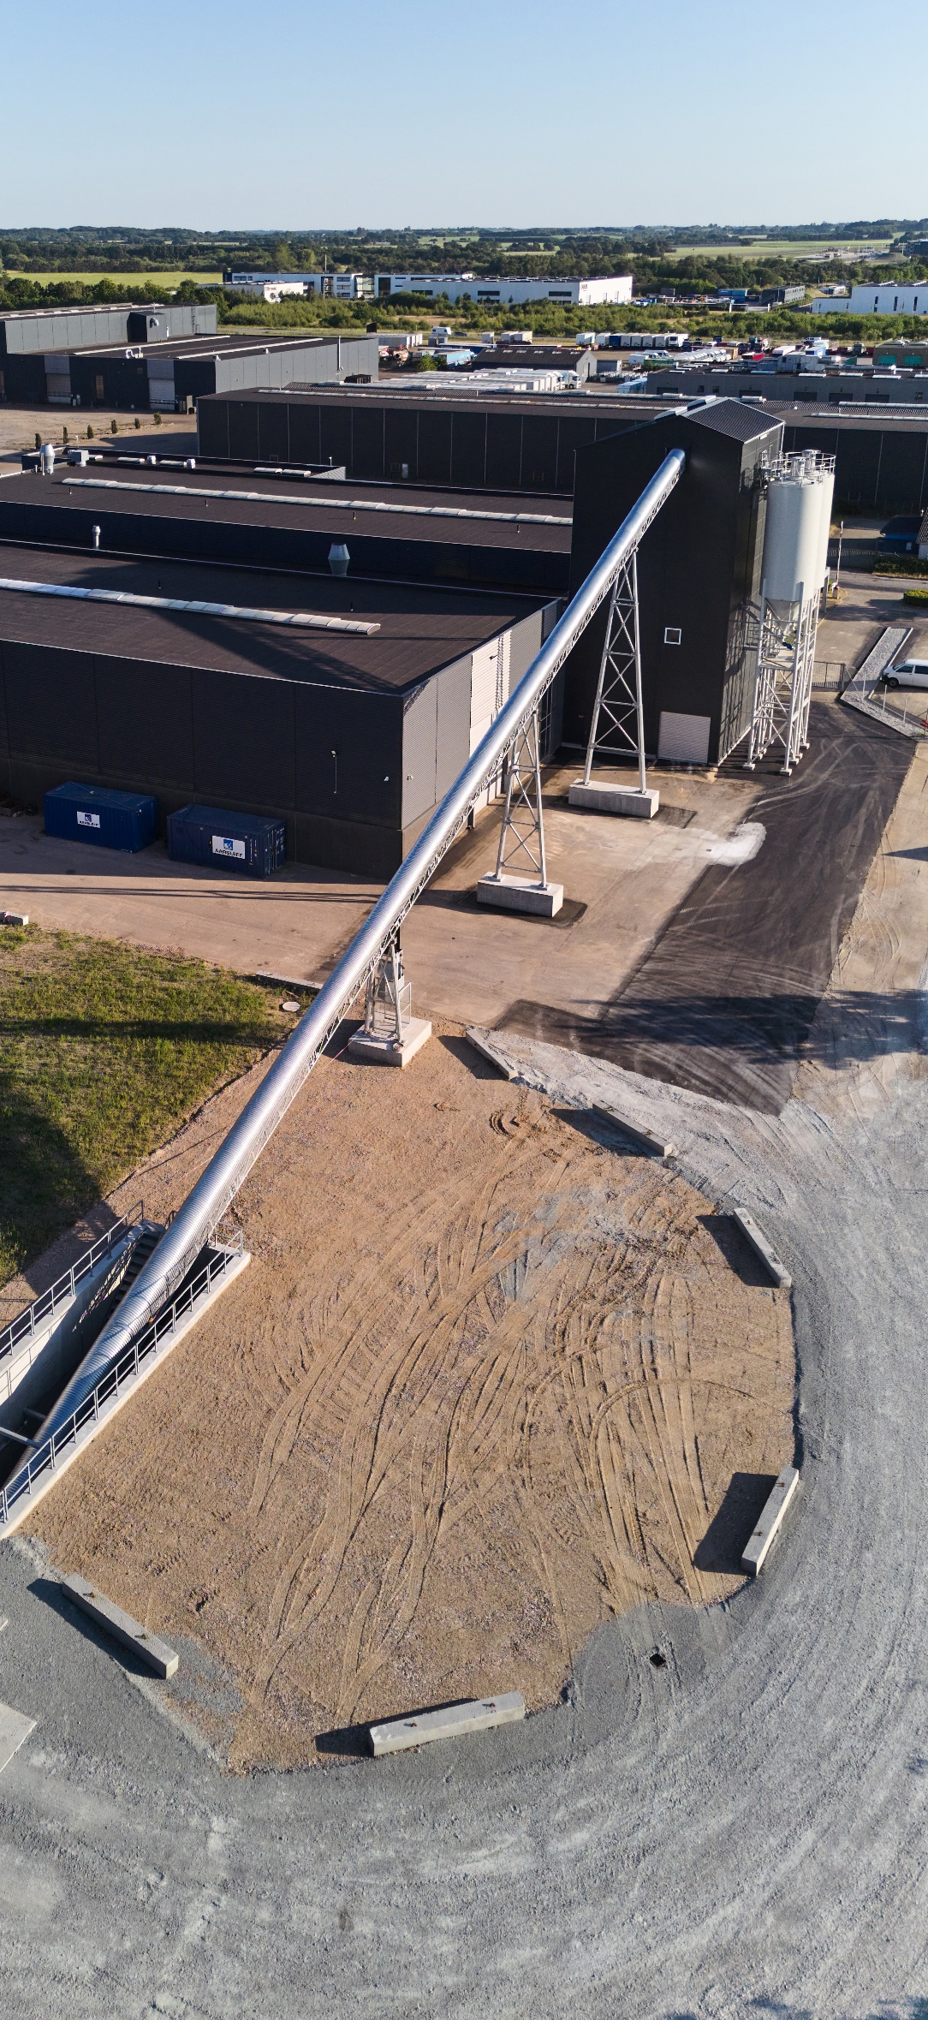
FINANCIAL PERFORMANCE IN Q2 2023
Financial performance in Q2 2023
The markets of SKAKO Concrete continue to show high level of activity, in line with what we saw in the previous quarters.
SKAKO Concrete continued the positive development on key markets resulting in strong growth in revenue, operating profit and order backlog.
As, in Q1 2023 SKAKO Concrete continued to experience a higher demand for plants from both existing and new customers.
Financial results
Below, the key financials for SKAKO Concrete in Q2 2023:
Revenue increased by 35% amounting to DKK 62.8m driven by an increase in the plant sales of 98% and a decrease of 8% in aftersales. Aftersales in H1 2023 was unchanged compared to same period in 2022.
Gross profit increased by 20% amounting to DKK 11.8m while gross profit margin decreased with 2.2pp. The decrease in margin was driven by the higher share of plant sales with a lower margin than aftersales.
Operating profit (EBIT) increased by 58% to DKK 3.8m driven by the growth in revenue and an increase in EBIT margin from 5.1% to 6.1% due to more or less unchanged capacity cost despite high revenue growth.
Order intake in Q2 2023 was DKK 73.5m compared to DKK 91.8m in the same period of 2022 fueling an order backlog of DKK 135.1m at the end of Q2 2023, an increase of 6.5% compared to last year. The order backlog was maintained at a high level above DKK 120m for the fifth consecutive quarter.

Slide 15
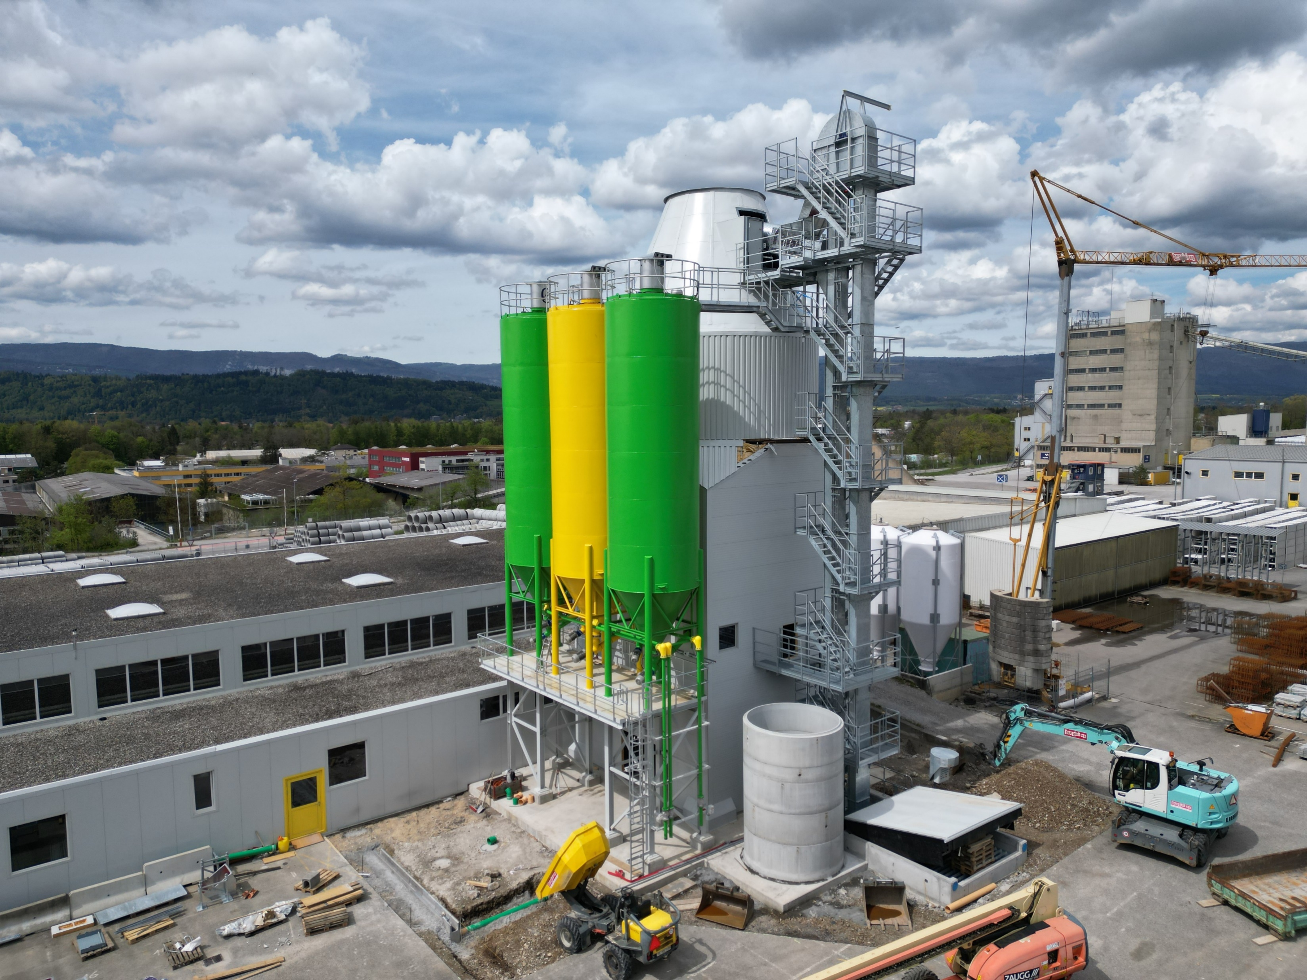
BUSINESS UPDATE
Growing order backlog
In the first half of 2023, SKAKO Concrete's order backlog was maintained at a high level above DKK 120m, and we are fully booked with projects until mid 2024.
We especially see a positive development in Germany, United Kingdom and United States.
Lately, we have established a cooperation with Erhvervshus Fyn (a Danish company that promotes business in Funen, Denmark) in order to investigate the potential within new markets.
Customer Satisfaction Survey
We have received the results from our customer satisfaction survey, made by In2Minds for the second year in a row, showing that customer satisfaction has increased.
Our NPS score has gone from 29 to 51. NPS stands for Net Promoter Score and is a way to measure customer loyalty. The score is calculated on the basis of the following question: On a scale of 0 – 10, how likely are you to recommend SKAKO to your friends, colleagues, and family?
A score higher than 40 indicates "top performance," while a score between 20 and 39 indicates a "very good performance," meaning that we have gone from a high level of satisfaction to an even higher level.
In the survey, the customers especially point out service and product quality as reasons to choose SKAKO Concrete.
We have also investigated the importance of sustainability among our customers. Most customers have sustainability in focus, and therefor find it essential to be offered sustainable products from SKAKO Concrete - a requirement we are ready to meet.
Knowledge about concrete
As a part of our strategy, we want to become more consultative. Therefore, we are planning several exclusive customer events in the local markets, where we will share knowledge about concrete with the customers.
The first local customer event will be in North Germany later this year. The theme of the event will be sustainability.
Aftersales
Customer care is essential for a business like SKAKO, and therefor we have sharpened our aftersales strategy. The plan is to reach more out to the customers to be ahead of their needs. To do so, we have employed two new Sales Managers, focusing on all the markets we operate in.

Slide 16
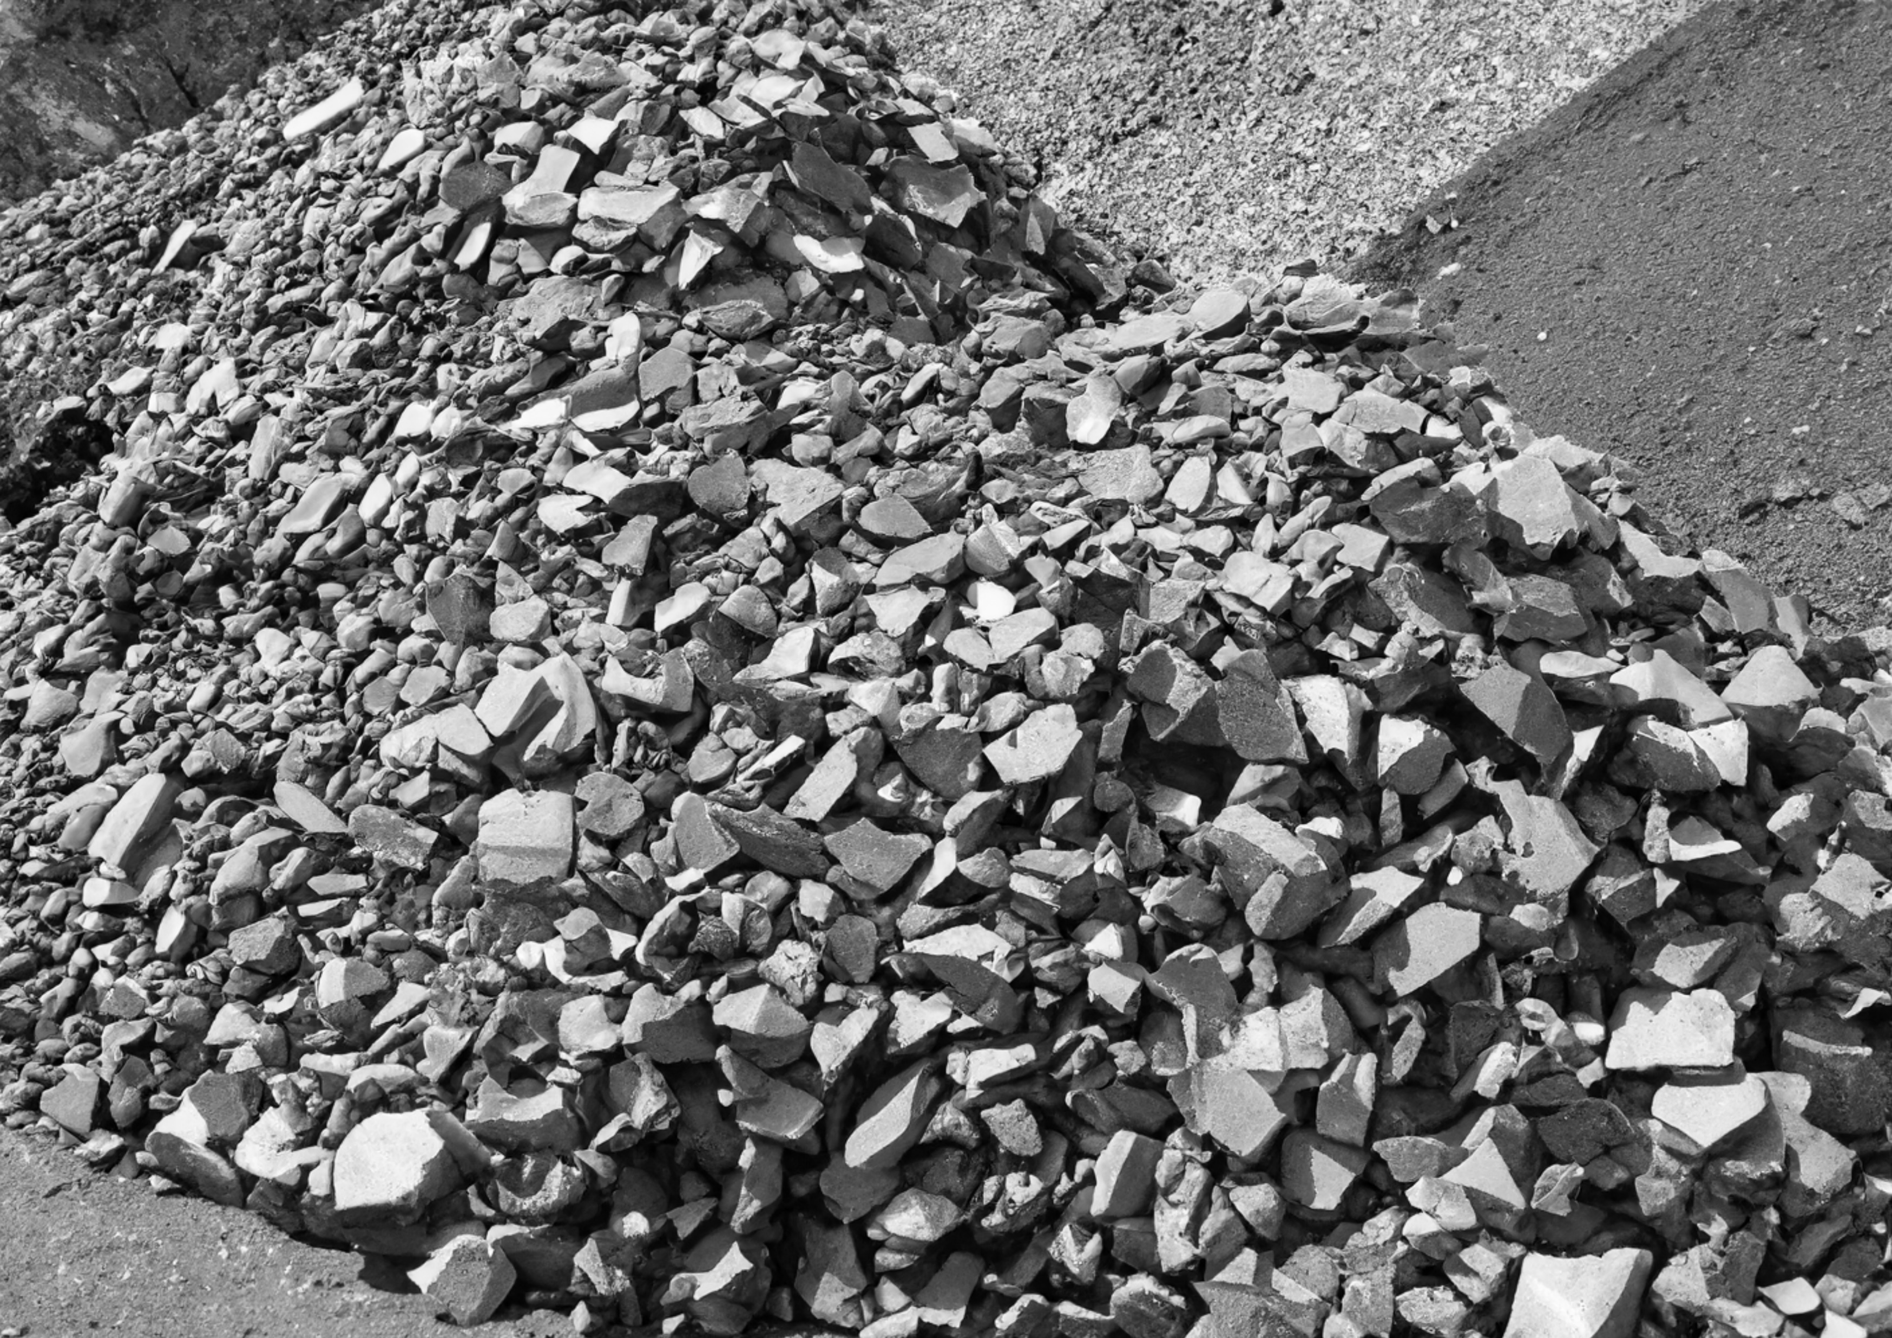
5. SKAKO VIBRATION
^{Quarterly report 2023}
^{Page 16}

Slide 17
Q2 2023 FINANCIAL REVIEW SKAKO VIBRATION
DKK thousands | Q2 2023 | Q2 2022 | Change | H1 2023 | H1 2022 | Change
Plant sales revenue | 43.9 | 44.2 | -0.7% | 88.1 | 81.8 | 7.7%
Aftersales revenue | 17.7 | 16.8 | 5.4% | 35.4 | 34.1 | 3.8%
Total revenue | 61.6 | 61.0 | 1.0% | 123.5 | 115.9 | 6.6%
Gross profit | 19.7 | 17.8 | 10.7% | 38.0 | 34.4 | 10.5%
Gross profit margin | 32.0% | 29.2% | 2.8pp | 30.7% | 29.7% | 1.0pp
Operating profit (EBIT) | 6.8 | 3.9 | 74.4% | 12.6 | 8.6 | 46.5%
Profit margin (EBIT margin) | 11.0% | 6.4% | 4.6pp | 10.2% | 7.4% | 2.8pp
Order backlog beginning of period | 78.0 | 72.7 | 7.3% | 72.6 | 53.9 | 34.7%
Order intake | 60.6 | 74.3 | -18.4% | 127.9 | 148.0 | -13.6%
Order backlog end of period | 77.0 | 84.5 | -8.9% | 77.0 | 84.5 | -8.9%

Slide 18
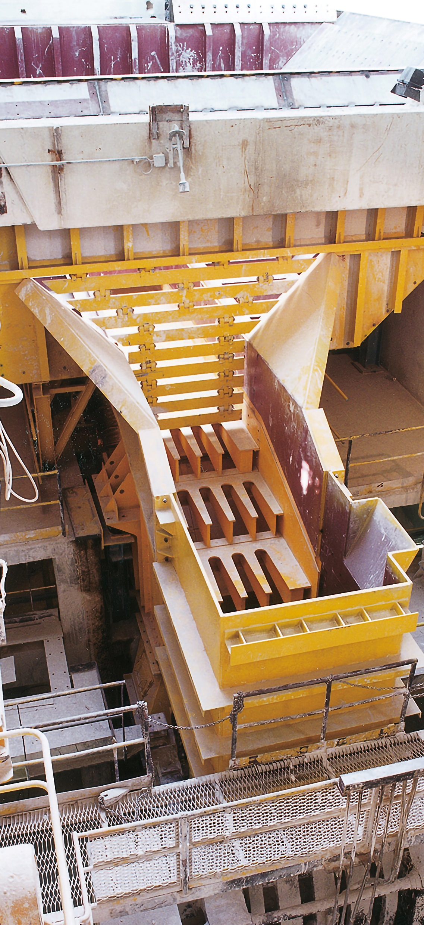
FINANCIAL PERFORMANCE IN Q2 2023
Financial performance in Q2 2023
For SKAKO Vibration, Q2 2023 ended with the same high momentum as in the previous quarters with revenue above DKK 60m and a stabile order backlog above DKK 70m.
Below, the key financials for SKAKO Vibration in Q2 2023:
Revenue increased by 1% amounting to DKK 61.6m driven by an increase in aftersales of 5% while plant sales decreased by 1%.
Gross profit increased by 11% amounting to DKK 19.7m due to growth in revenue and an increase in gross profit margin of 2.8pp. The increase in margin was driven by the higher share of the aftersales with higher margin than plant sales.
Operating profit (EBIT) increased with 74% to DKK 6.8m due to growth in revenue and an increase in EBIT margin of 4.6pp to 11.0%. The increase in EBIT margin was driven by a higher gross profit margin and a lower growth in capacity costs than the growth in revenue.
Order intake in Q2 2023 was DKK 60.6m compared to DKK 74.3m in the same period of 2022 fueling an order backlog of DKK 77.0m at the end of Q2 2023, a decrease of 8.9% compared to last year but still at a high level.

Slide 19
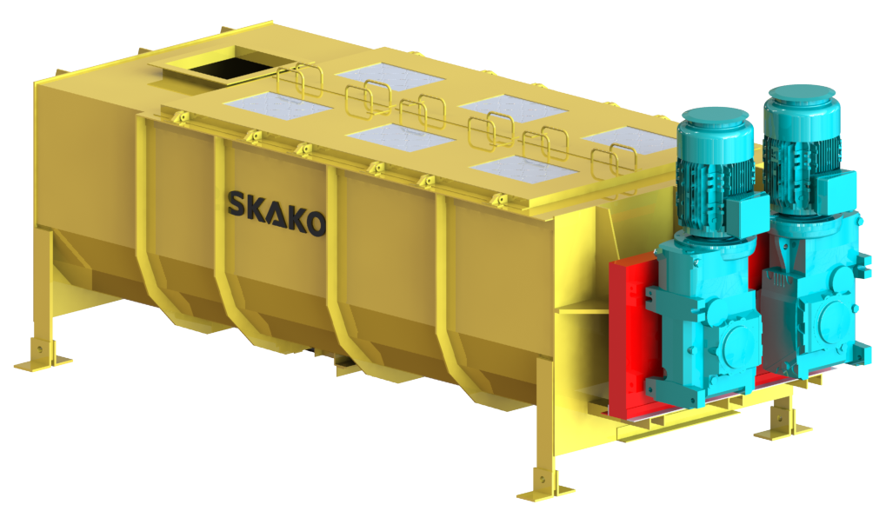
BUSINESS UPDATE
Growth
The positive development continued in Q2 2023 with high customer investments, particularly in the Mineral and Recycling segments.
Sharing of knowledge between business units
As a part of our strategy, we want to increase the synergies between SKAKO Vibration's business units in Denmark, France, and Spain. During the last few months, we have been focusing on sharing each company's best practices on a technical level to make work easier and faster for our employees.
Our know-how is based on years of development experience in the Mineral, Recycling, and Fastener segments, but the vibratory technology is the same, which is why we often encounter common technical challenges across the segments. By sharing our know-how between the segments, these challenges will be easier to overcome.
The European recycling market
Our pipeline of recycling projects has evolved considerably in the first half of 2023 driven by the entire European market and no longer mainly by the markets of Southern Europe.
This is in line with our deployment strategy, based on our matrix organization for the three business segments.
Previously, our sales organization was only based on geographic markets, but from the beginning of the year, it has also been based on our three business segments. With this change, we are now accelerating the development of sales in each segment by freeing ourselves from geographical constraints and matching customer needs with our most efficient solutions.
This strategy has particularly been effective in the recycling sector, where we, throughout the last years, have developed strongly in Spain and Portugal through SKAKO Dartek. The challenges we have met in those countries are the same as in other European countries because the EU has adopted a strong action plan through the “European Green Deal” to develop the circular economy. This has resulted in common rules that can be found in all EU countries - which, of course, have a significant impact on the recycling sector.
All this bodes well for the future of SKAKO Vibration.

Slide 20
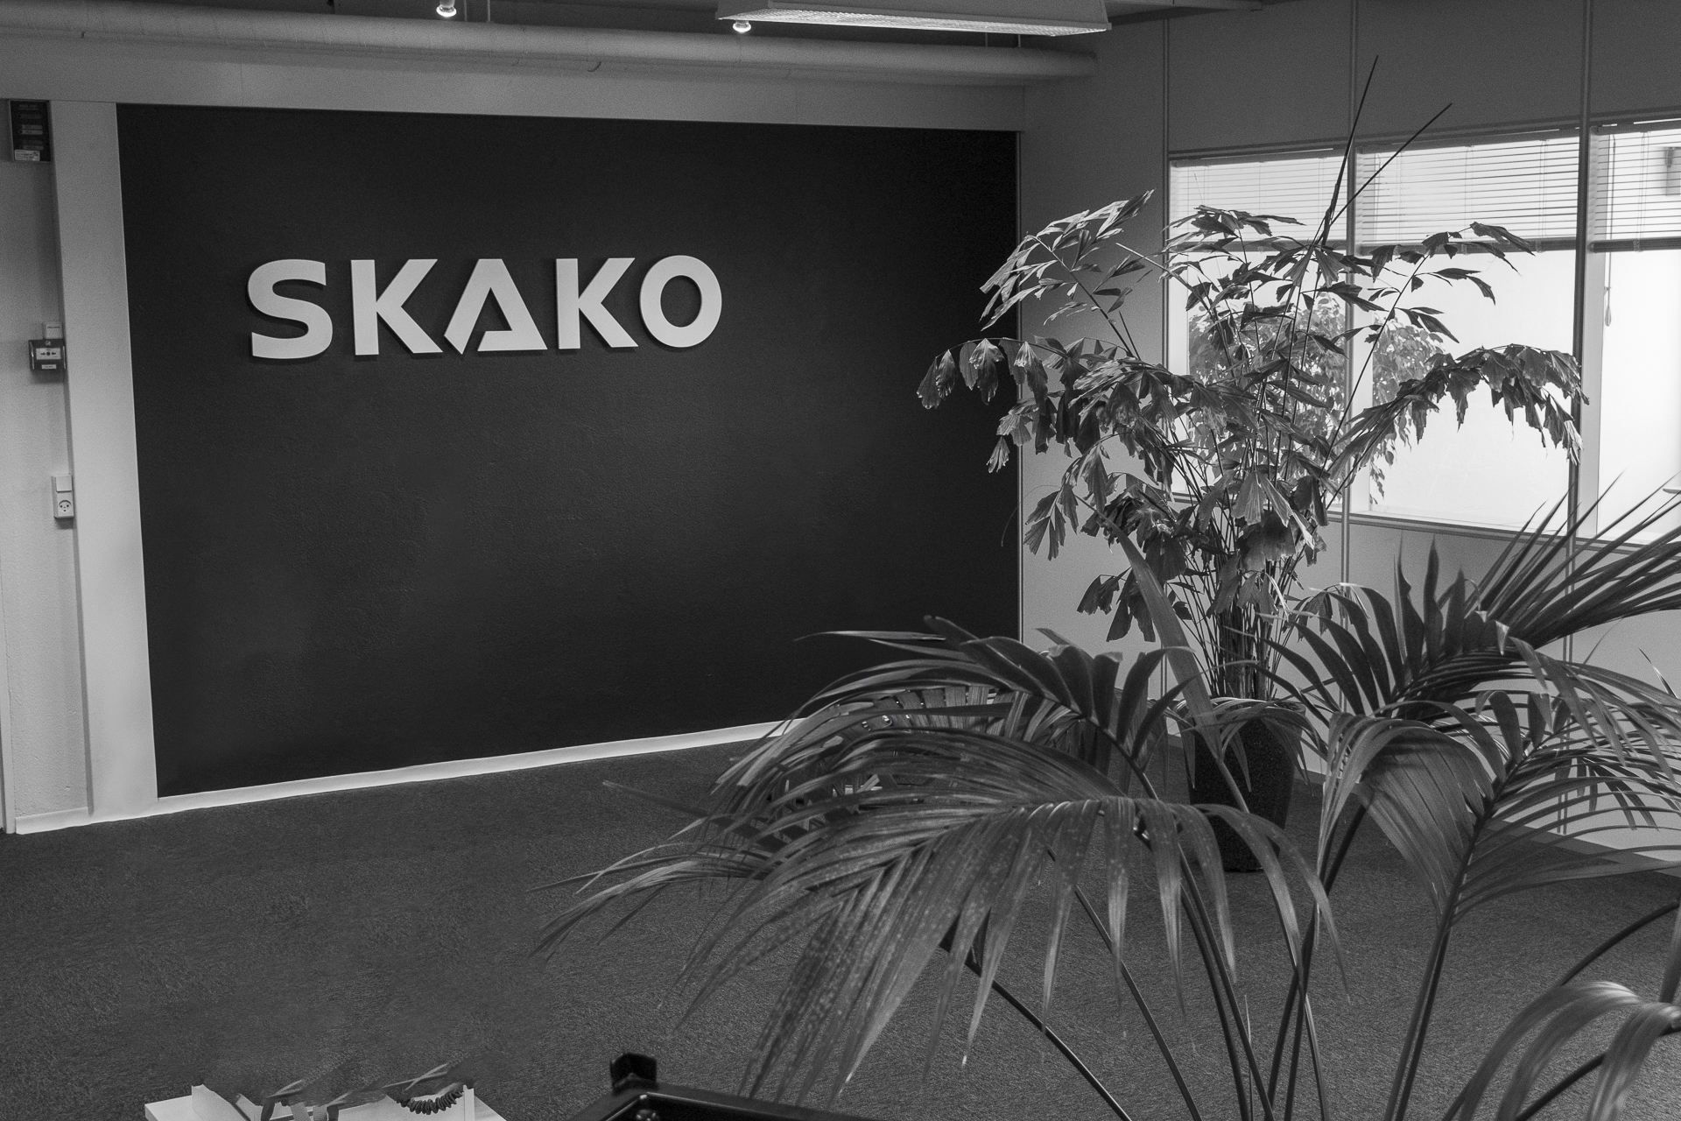
6. FINANCIAL STATEMENTS
^{Quarterly report 2023}
^{Page 20}

Slide 21
6.1 STATEMENT BY MANAGEMENT
We have considered and approved the interim report of SKAKO A/S for the period 1 January – 30 June 2023.
The interim report, which has not been audited or reviewed by our auditors, has been prepared in accordance with IAS 34 Interim financial reporting, as adopted by the European Union and accounting policies set out in the annual report for 2021 of SKAKO A/S. Furthermore, the interim report for the period 1 January – 30 June 2023 has been prepared in accordance with additional Danish disclosure requirements for interim reports of listed companies.
In our opinion, the interim financial report gives a true and fair view of the Group’s assets, liabilities, and financial position on 30 June 2023 and of the results of the Group’s operations and cash flows for the six three months of 2023.
We also believe that the Management commentary contains a fair review of the development in the Group’s business and financial position, the results for the period and the Group’s financial position as well as a description of the principal risks and uncertainties facing SKAKO.
^{Faaborg, 23 August 2023}
EXECUTIVE BOARD
DIRECTOR
DIRECTOR
Group CFO
Steffen Kremmer
Lionel Girieud
Thomas Pedersen
BOARD OF DIRECTORS
CHAIRMAN
DEPUTY CHAIRMAN
Carsten Krogsgaard Thomsen
Christian Herskind Jørgensen
Jens Wittrup Willumsen
Lars Tveen
Sophie Louise Knauer

Slide 22
6.2 CONSOLIDATED INCOME STATEMENT
DKK thousands | Q2 2023 | Q2 2022 | H1 2023 | H1 2022 | 2022
Revenue from contracts with customers | 122,774 | 106,584 | 252,134 | 202,601 | 437,920
Production costs | (92,168) | (80,250) | (192,734) | (150,938) | (323,283)
Gross profit | 30,606 | 26,334 | 59,400 | 51,663 | 114,637
Distribution costs | (11,648) | (11,181) | (23,320) | (22,565) | (43,923)
Administrative expenses | (9,251) | (9,882) | (18,545) | (18,272) | (39,872)
Operating profit (EBIT) before special items | 9,707 | 5,271 | 17,535 | 10,826 | 30,842
Special items | - | (1,650) | (1,934) | (1,650) | (1,650)
Operating profit (EBIT) after special items | 9,707 | 3,620 | 15,601 | 9,175 | 29,192
Financial income | 322 | - | 552 | - | 916
Financial expenses | (1,863) | (1,266) | (3,127) | (1,738) | (5,878)
Profit before tax | 8,166 | 2,354 | 13,026 | 7,437 | 24,230
Tax on profit for the period | (2,078) | (132) | (3,564) | (1,599) | 844
Profit for the period | 6,088 | 2,222 | 9,462 | 5,838 | 25,074
Profit for the period attributable to SKAKO A/S shareholders | 6,088 | 2,222 | 9,462 | 5,838 | 25,074
Earnings per share (EPS), DKK | 1.97 | 0.72 | 3.07 | 1.89 | 8.13
Diluted earnings per share (EPS), DKK | 1.97 | 0.72 | 3.07 | 1.89 | 7.83

Slide 23
6.3 CONSOLIDATED STATEMENT OF COMPREHENSIVE INCOME
DKK thousands | Q2 2023 | Q2 2022 | H1 2023 | H1 2022 | 2022
Profit for the period | 6,088 | 2,222 | 9,462 | 5,838 | 25,074
Other comprehensive income:
Items that have been or may subsequently be reclassified to the income statement:
Foreign currency translation, subsidiaries | 1,754 | 1,834 | 2,463 | 1,851 | 533
Value adjustments of hedging instruments | (1) |  | 5 | 1 | -
Other comprehensive income | 1,753 | 1,834 | 2,468 | 1,852 | 533
Comprehensive income | 7,841 | 4,056 | 11,930 | 7,690 | 25,607
Comprehensive income attributable to SKAKO A/S shareholders | 7,841 | 4,056 | 11,930 | 7,690 | 25,607

Slide 24
6.4 CONSOLIDATED BALANCE SHEET 30 June
DKK thousands | 30 June 2023 | 30 June 2022 | 31 December 2022
Intangible assets | 34,696 | 36,609 | 36,188
Intangible assets under development | 5,549 | 2,454 | 4,237
Intangible assets | 40,245 | 39,063 | 40,425
Leased assets | 13,397 | 7,646 | 8,786
Land and buildings | 7,227 | 5,691 | 5,821
Plant and machinery | 1,397 | 1,023 | 1,238
Operating equipment, fixtures and fittings | 2,325 | 1,698 | 2,458
Leasehold improvements | 3,325 | 2,762 | 2,906
Tangible assets under construction | 938 | 85 | 156
Property, plant and equipment | 28,609 | 18,905 | 21,365
Other receivables | 1,236 | 1,292 | 1,234
Deferred tax assets | 25,420 | 20,605 | 25,575
Other non-current assets | 26,656 | 21,897 | 26,809
Total non-current assets | 95,510 | 79,865 | 88,599
Inventories | 80,369 | 77,203 | 72,740
Trade receivables | 119,182 | 81,653 | 101,385
Contract assets | 57,487 | 62,062 | 63,876
Income tax | - | 525 | -
Other receivables | 8,015 | 8,323 | 9,270
Prepaid expenses | 3,718 | 4,976 | 3,045
Cash | 49,598 | 11,336 | 45,142
Current assets | 318,369 | 246,078 | 295,458
Assets | 413,879 | 325,943 | 384,057

Slide 25
CONSOLIDATED BALANCE SHEET 30 JUNE CONTINUED
DKK thousands | 30 June 2023 | 30 June 2022 | 2022
Share capital | 31,064 | 31,064 | 31,064
Foreign currency translation reserve | (2,020) | 1,400 | 82
Hedging reserve | (44) | (48) | (49)
Proposed dividends | - | - | 15,532
Retained earnings | 113,565 | 95,507 | 99,538
Equity | 142,565 | 127,923 | 146,167
Other payables | 4,237 | 7,728 | 7,562
Leasing | 9,532 | 4,762 | 5,416
Loans and borrowings | 10,917 | 11,478 | 9,150
Provisions | 4,047 | 6,088 | 4,345
Non-current liabilities | 28,733 | 30,056 | 26,473
Loans and borrowings | 9,347 | 9,211 | 9,828
Bank loans and credit facilities | 73,370 | 13,212 | 38,119
Leasing | 4,051 | 2,844 | 3,626
Provisions | 4,036 | 625 | 3,530
Contract liabilities | 37,072 | 32,013 | 46,829
Trade payables | 79,686 | 82,417 | 81,200
Income tax | 4,215 | 1,239 | 997
Other liabilities | 30,804 | 26,928 | 27,288
Deferred income | - | 475 | -
Current liabilities | 242,581 | 168,964 | 211,417
Liabilities | 271,314 | 198,020 | 237,890
EQUITY AND LIABILITIES | 413,879 | 325,943 | 384,057

Slide 26
6.5 CONSOLIDATED CASH FLOW STATEMENT
DKK thousands | Q2 2023 | Q2 2022 | H1 2023 | H1 2022 | 2022
Profit before tax | 8,166 | 2,354 | 13,026 | 7,437 | 24,230
Adjustments | 3,223 | 4,097 | 6,067 | 6,572 | 16,341
Changes in receivables, etc. | (16,167) | 18 | (10,828) | (5,385) | (25,890)
Change in inventories | (3,263) | (7,928) | (7,629) | (13,123) | (9,367)
Change in trade payables and other liabilities, etc. | (5,518) | 13,319 | (7,861) | 16,249 | 30,351
Cash flow from operating activities before financial items and tax | (13,559) | 11,860 | (7,225) | 11,750 | 35,665
Financial items received and paid | (1,541) | (1,266) | (2,575) | (1,738) | (4,710)
Taxes paid and received | (227) | (51) | (645) | 556 | (2,105)
Cash flow from operating activities | (15,327) | 10,542 | (10,445) | 10,568 | 28,850
Investment in intangible assets | (47) | (1,238) | (80) | (1,473) | (4,153)
Investment in tangible assets | (2,881) | (540) | (9,707) | (1,005) | (6,174)
Acquisition of entities | - | - | - | - | 1,690
Cash flow from investing activities | (2,928) | (1,779) | (9,787) | (2,479) | (8,637)
Change in borrowings | (848) | (3,183) | 5,827 | (1,797) | -
Repayments | - | - | - | - | (2,072)
Paid dividends | (15,532) | (12,336) | (15,532) | (12,336) | (12,335)
Change in short-term bank facilities | 29,704 | 1,780 | 35,251 | (22,758) | 2,149
Cash flow from financing activities | 13,324 | (13,739) | 25,546 | (36,891) | (12,258)
Change in cash and cash equivalents | (4,931) | (4,975) | 5,315 | (28,802) | 7,955
Cash and cash equivalents beginning of the period | 55,006 | 15,091 | 45,142 | 39,075 | 39,075
Foreign exchange adjustment, cash and cash | (477) | 1,220 | (859) | 1,063 | (1,888)
Cash and cash equivalents at the end of the period | 49,598 | 11,336 | 49,598 | 11,336 | 45,142
Breakdown of cash and cash equivalents at the end of the year:
Cash and other investments | 49,598 | 11,336 | 49,598 | 11,336 | 45,142
Cash and cash equivalents at the end of the year: | 49,598 | 11,336 | 49,598 | 11,336 | 45,142

Slide 27
6.6 CONSOLIDATED STATEMENT OF CHANGES IN EQUITY
 | Shared capital | Foreign currency translation reserve | Hedging reserve | Retained earnings | Proposed dividends | Equity
Equity 1 January 2023 | 31,064 | 82 | (49) | 99,538 | 15,532 | 146,167
Comprehensive income in Q1 2023
Profit for the period |  |  |  | 9,462 |  | 9,462
Paid dividends |  |  |  |  | (15,532) | (15,532)
Other comprehensive income:
Foreign currency translation |  | 2,299 |  |  |  | 2,299
adjustments, subsidiaries
Value adjustments of hedging instruments |  |  | 5 |  |  | 5
Other comprehensive income
Comprehensive income, period |  | 2,299 | 5 | 9,462 | (15,532) | (3,766)
Share-based payment, warrants |  |  |  | 164 |  | 164
Equity 30 June 2023 | 31,064 | 2,381 | (44) | 109,164 | - | 142,565

Slide 28
CONSOLIDATED STATEMENT OF CHANGES IN EQUITY CONTINUED
 | Shared capital | Foreign currency translation reserve | Hedging reserve | Retained earnings | Proposed dividends | Equity
Equity 1 January 2022 | 31,064 | (451) | (49) | 89,338 | 12,335 | 132,237
Paid dividends |  |  |  |  | (12,335) | (12,335)
Comprehensive income in 2022:
Profit for the period* |  |  |  | 5,838 |  | 5,838
Other comprehensive income:
Foreign currency translation adjustments, subsidiaries |  | 1,851 |  |  |  | 1,851
Value adjustments of hedging instruments |  |  | 1 |  |  | 1
Other comprehensive income
Comprehensive income, period | - | 1,851 | 1 | 5,838 | (12,335) | (4,645)
Share-based payment, warrants |  |  |  | 331 |  | 331
Equity 30 June 2022 | 31,064 | 1,400 | (48) | 95,507 | - | 127,923

Slide 29
6.7 Segment information
H1 2023 | Concrete | Vibration | Not distributed including parent company | Eliminations | Group total
Revenue, external | 131,859 | 120,275 |  |  | 252,134
Revenue, internal | 4 | 3,238 |  | (3,242) | -
Total revenue | 131,863 | 123,513 |  | (3,242) | 252,134
Depreciations | (1,632) | (1,754) |  |  | (3,386)
Operating profit (EBIT) before special items | 6,981 | 12,640 | (2,086) |  | 17,535
Special items | - | - | (1,934) |  | (1,934)
Operating profit (EBIT) after special items | 6,981 | 12,640 | (4,020) |  | 15,601
Order backlog, beginning | 142,651 | 72,551 |  |  | 215,202
Order intake | 124,212 | 127,946 |  | (2,793) | 249,365
Order backlog, ending | 135,069 | 76,984 |  | 380 | 212,433
Segment non-current assets | 40,178 | 44,554 | 176,989 | (166,211) | 95,510
Segment assets | 227,638 | 244,117 | 185,134 | (243,010) | 413,879
Segment liabilities | 151,696 | 125,655 | 66,764 | (72,801) | 271,314
Investments in intangible and tangible asset | 2,329 | 7,458 |  |  | 9,787
Average number of employees | 97 | 111 |  |  | 208

Slide 30
SEGMENT INFORMATION CONTINUED
H1 2022 | Concrete | Vibration | Not distributed including parent company | Eliminations | Group total
Revenue, external | 88,931 | 113,670 |  |  | 202,601
Revenue, internal | 6 | 2,244 |  | (2,250) | -
Total revenue | 88,937 | 115,914 |  | (2,250) | 202,601
Depreciations | (1,549) | (1,558) |  |  | (3,107)
Operating profit (EBIT) before special items | 4,004 | 8,587 | (1,766) |  | 10,825
Special items | - | - | (1,650) |  | (1,650)
Operating profit (EBIT) after special items | 4,004 | 8,587 | (3,416) |  | 9,175
Order backlog, beginning | 71,822 | 52,373 |  | (131) | 124,064
Order intake | 143,880 | 147,997 |  | (2,003) | 289,874
Order backlog, ending | 126,764 | 84,456 |  | (379) | 210,841
Segment non-current assets | 30,551 | 41,197 | 8,117 |  | 79,865
Segment assets | 148,921 | 225,018 |  | (47,996) | 325,943
Segment liabilities | 88,510 | 127,393 |  | (17,882) | 198,021
Investments in intangible and tangible asset | 871 | 1,608 |  |  | 2,479
Average number of employees | 84 | 109 | 12 |  | 205

Slide 31
6.8 QUARTERLY KEY FIGURES AND FINANCIAL RATIOS
DKK thousands | Q2 2023 | Q1 2023 | Q4 2022 | Q3 2022 | Q2 2022 | Full year 2022
INCOME STATEMENT
Revenue | 122,774 | 129,360 | 124,254 | 111,065 | 106,584 | 437,920
Gross profit | 30,606 | 28,794 | 36,682 | 26,292 | 26,334 | 114,637
Operating profit (EBIT) before special items | 9,707 | 7,828 | 10,881 | 9,136 | 5,270 | 30,842
Operating profit (EBIT) after special items | 9,707 | 5,894 | 10,881 | 9,136 | 3,620 | 29,192
Net financial items | (1,541) | (1,034) | (3,470) | 246 | (1,266) | (4,962)
Profit before tax | 8,166 | 4,860 | 7,411 | 9,382 | 2,354 | 24,230
Profit for the year | 6,088 | 3,374 | 11,117 | 8,119 | 2,222 | 25,074
BALANCE SHEET
Non-current assets | 95,510 | 92,780 | 88,599 | 80,776 | 79,865 | 88,599
Current assets | 318,369 | 304,346 | 295,458 | 253,727 | 246,078 | 295,458
Assets | 413,879 | 397,126 | 384,057 | 334,503 | 325,943 | 384,057
Equity | 142,565 | 150,256 | 146,167 | 133,454 | 127,923 | 146,167
Non-current liabilities | 28,733 | 28,652 | 26,473 | 29,640 | 30,056 | 26,473
Current liabilities | 242,581 | 218,218 | 211,417 | 171,413 | 167,965 | 211,417
Net debt | 57,619 | 23,355 | 20,997 | 28,444 | 30,171 | 20,997
Net working capital | 140,280 | 113,514 | 110,681 | 113,387 | 106,488 | 110,681
OTHER KEY FIGURES
Investment in intangible and tangible assets | 2,928 | 6,859 | 4,557 | 296 | 1,779 | 7,332
Cash flow from operating activities (CFFO) | (16,286) | 4,883 | 13,731 | 4,687 | 10,542 | 28,850
Free cash flow | (19,214) | (1,976) | 7,840 | 4,390 | 8,763 | 20,183
Average number of employees | 208 | 207 | 205 | 199 | 205 | 205

Slide 32
QUARTERLY KEY FIGURES AND FINANCIAL RATIOS CONTINUED
DKK thousands | Q2 2023 | Q1 2023 | Q4 2022 | Q3 2022 | Q2 2022 | Full year 2022
FINANCIAL RATIOS
Gross profit margin | 24.9% | 22.3% | 29.5% | 23.7% | 24.7% | 26.2%
Profit margin (EBIT margin) before special items | 7.9% | 6.1% | 8.8% | 8.2% | 5.0% | 7.0%
Profit margin (EBIT margin) after special items | 7.9% | 4.6% | 8.8% | 8.2% | 3.4% | 6.7%
Liquidity ratio | 131.2% | 139.5% | 139.8% | 148.0% | 145.6% | 140.1%
Equity ratio | 34.4% | 37.8% | 38.1% | 39.9% | 39.0% | 38.3%
Return on equity | 21.2% | 17.4% | 18.0% | 14.4% | 10.6% | 17.9%
ROIC | 16.9% | 17.1% | 16.8% | 13.6% | 11.1% | 16.5%
Financial leverage | 40.4% | 15.5% | 14.4% | 21.3% | 24.2% | 14.2%
Net debt to EBITDA | 1.3 | 0.7 | 0.5 | 0.8 | 1.0 | 0.5
NWC/revenue | 28.8% | 24.1% | 25.1% | 27.0% | 27.3% | 25.3%
Earnings per share | 1.97 | 1.09 | 3.61 | 2.63 | 0.72 | 8.13
Equity value per share | 46.23 | 48.72 | 47.40 | 43.28 | 41.48 | 48.0
Share price | 73.5 | 81.0 | 62.6 | 50.00 | 55.00 | 62.6
Price-book ratio | 1.59 | 1.66 | 1.32 | 1.16 | 1.33 | 1.3
Market capitalization | 228,322 | 251,620 | 194.462 | 155,321 | 170.853 | 194,461

Slide 33
FINANCIAL RATIO
Financial ratios are calculated as follows:
Gross profit margin = Gross profit x 100 / Revenue
Profit margin = EBIT x 100 / Revenue
EBIT margin before special items = EBIT before special items x 100 / Revenue
EBIT after special items = EBIT after special items x 100 / Revenue
Liquidity ratio = Total current assets x 100 / Total current liabilities
Equity ratio = Total equity x 100 / Total assets
Return on equity = Profit for the period x 100 / (Equity this year + equity prior year) / 2*
Financial leverage = Net interest-bearing debt x 100 / Equity
Net debt to EBITDA = Net debt / EBITDA (EBIT less depreciations)*
NWC/Revenue = Net working capital x 100 / Revenue*
Earnings per share = Profit for the period / Shares in free flow
Equity value per share = Equity / Total shares
Share price = Share price at end of period
Price-book ratio = Share price / Equity per share
Market capitalization = Total number of share x Share price
ROIC = NOPAT / (Invested capital this year + invested capital prior year) / 2*
NOPAT = Profit for the period +/- net financial income*
Invested capital = Total assets - net cash and credits - deferred tax
* Measured over a 12-month period

Slide 34
Bygmestervej 2
DK-5600 Faaborg
Denmark
Tel.: +45 6311 3860
skako.dk@skako.com
www.skako.com
CVR No. 36440414

