Slide 1
RomReal Limited
Investor presentation
Fourth Quarter (Q4) 2021 results
Kjetil Gronskag
25 February 2022
This Presentation of the Q4 2021 results of RomReal Ltd (the “Company”) has been prepared for discussion purposes only and should be read in conjunction with the Q4 2021
Report which is filed on Oslo Axess through www.newsweb.no, and which can be viewed on the Company’s website www.romreal.com

Slide 2
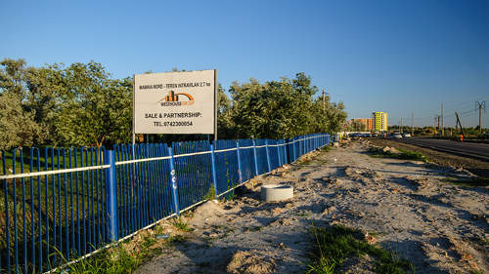
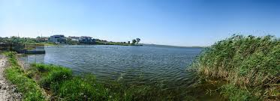
Contents
 | Q4 2021 highlights | 3-4
 | NAV movement in Q4 2021 | 5
 | Financial highlights 4Q.21 – IFRS | 6
 | RomReal Properties per 4Q 2021 | 7
 | Operational highlights | 8-9
 | Romania Macro Developments | 10
 | Romania Real Estate Update | 11
 | Apartment Price Development | 12
 | RomReal shareholders | 13
 | Main focus areas going forward | 14
 | Contact details | 15

Slide 3
Q4 2021 results – Highlights
Net Asset Value (NAV)
Net Asset value was EUR 0.41 (NOK 4.33, before any tax) per share, about 5.5% higher compared to the end of the third quarter 2021
The year-end 2021 valuation was concluded by Colliers in January 2022 and reflects the updated market conditions and the respective valuations of the Group’s land bank. Of note, the valuation report reflects the Group’s efforts in enhancing the value of its assets, in particular the development of the Lakeside and Oasis plots.
Operational highlights
During the fourth quarter of 2021, the Company sold a further 14 plots from the Ovidiu Lake Side project for a total consideration of EUR 0.6m. Total infrastructure investments by end of 4th quarter 2021 was EUR 3.2m. This is well below record sales in third quarter 2021.
Following the end of Q4 2021, the Company concluded 4 small sale transactions in total (3 on Lake Side) for a consideration of EUR 0.23m and binding agreements have been signed/paid.

Slide 4
Q4 2021 results – Highlights
Financial Results
Net Result for the quarter was EUR 901,000, compared to a EUR 3.439,000 loss in 4Q 2020. Net change in cash flow for the quarter was a positive EUR 226,000 compared to negative of EUR 1,350,000 in the same period last year. This was mainly due to the ongoing sales realised during the quarter.
At the end of the quarter, the Company had a cash position of EUR 3.8 million plus a total of EUR 4.1m in unsettled receivables related to binding sales agreements, totalling EUR 7.9m, or about EUR 0.19 per share.
Macro and real estate market highlights
Romania's GDP expanded by 5.6% during 2021, according to flash data from the National Statistics Institute.
The 12 month inflation rate up to January 2022 was 8,35%.
Asking prices for apartments and houses in Romania continued to raise in the last quarter of 2021 compared the third quarter of 2021, up to EUR 1,593/m2 at the end of Q4 and EUR 1,596/ m2 at the end of January 2022. In Constanta, average prices increased by 3.5% during the fourth quarter of 2021 (EUR 1,408/m2 at the end of December 2021, compared to EUR 1,360/sqm at the end of September 2021), according to www.imobiliare.ro index.

Slide 5
NAV movement in Q4 2021
Asset base | Q4 2021 |  |  | Q3 2021
 | EUR ’000 | EUR/ share | NOK/share | EUR ’000 | EUR/ share | NOK/share
Investment property | 4,997 | 0.12 | 1.29 | 2,768 | 0.07 | 0.71
Assets held for sale | 2,480 | 0.06 | 0.64 | 2,254 | 0.05 | 0.58
Inventories | 5,707 | 0.14 | 1.47 | 7,700 | 0.19 | 1.98
Cash | 3,807 | 0.09 | 0.98 | 3,581 | 0.09 | 0.92
Other assets/(liabilities) | (173) | (0.00) | (0.04) | (356) | (0.01) | (0.09)
Net asset value | 16,819 |  |  | 15,947
NAV/Share |  | 0.41 | 4.10 |  | 0.39 | 4.10
Change in NAV vs previous quarter | 5.5% |  |  | 6.1%
The average number shares used in the NAV calculation above is 41,367,783 shares and unchanged from Q3 2021.
RomReal Limited – Fourth quarter 2021

Slide 6
Financial highlights 4Q.21- IFRS
EUR '000 | Q4 2021 | Q4 2020
Operating Revenue | 1,079 | 446
Operating Expenses | 995 | (1,994)
Other operating income/ (expense), net | (1,127) | (1,909)
Net financial income/(cost) | (1) | 5
Pre-tax result | 946 | (3,453)
Result for the period | 893 | (3,439)
Total assets | 18,037 | 15,340
Total liabilities | 1,219 | 305
Total equity | 16,819 | 15,035
Equity % | 93.2% | 98.0%
NAV per share (EUR) | 0.41 | 0.36
Cash position | 3,807 | 1,207
RomReal Limited – Fourth quarter 2021

Slide 7
RomReal Properties Q4 2021
Plot name | Location | Size (m2)
1 Ovidiu Lakeside | Constanta North/Ovidiu | 18.288
2 Badulescu plot | Constanta North/Ovidiu | 50,000
3 Ovidiu (Oasis) | Constanta North/Ovidiu | 23,685
4 Centrepoint | Constanta North/Ovidiu | 121,672
5 Gunaydin plot | Constanta North/Ovidiu | 15,000
6 Balada Market | Central Constanta | 7,188
Total |  | 235.833
For further information on the properties please visit www.romreal.com
7

Slide 8
Operational highlights
Lake Side (No.1 on the table) – The Company has on-going processes for plot sales in the area and sold 14 plots during fourth quarter and another 3 plots hitherto 2022. Street and utilities have been delivered to the City Hall for public use according to agreement.
Oasis (No. 3 on the table) – The Company has commenced the process to re-authorise the works to finalise the blocks erected on site. This in order to add value to the plot and authorise the works for constructing the utilities in the area, with required permits hopefully granted during first half 2022. The Company is close to finalising stage 1 of bringing gas to the project. In November 2021, the Board made a principal decision to finalise the two block structures and upgrade the four houses on the plot. This to hopefully improve profits and speed up exit.
Industrial Park (No. 4 on the table) – The Company is engaged in a process with an international company to sell parts of the plot, but no binding agreement is signed.
Balada Market (No. 6 on the table) - The project is for sale. In order to its increase income, a regulation process to utilise a larger part of the plot for parking has commenced and some progress has been made with the local authorities. About three quarters of the pedestrian walk on the property is upgraded.
Ovidiu Residence (former Badulescu plot (No. 2 on the table) – Based on the Lakeside plot experience, the Company has commenced a process to regulate this plot located nearby Lakeside for residential and commercial use. Regular meetings with local and road authorities are taking place.
Ovidiu Residence 2 (former 7,900 sqm)- The Company has commenced a process to regulate the plot located nearby Lakeside for residential use. This will include infrastructure investments.
Ovidiu Residence 3 (former 7,100 sqm)- The Company has commenced commence a process to regulate the plot located nearby the road between Ovidiu and Constanta for residential use. It is expected to include infrastructure investments

Slide 9
Operational highlights 2
Restitution claim, plot of 1,453 sqm, Constanta Court case no. 2567/118/2016
The piece of land is agreed sold to the buyer of the Company’s previous Mamaia North plot and the agreed proceeds about EUR 390,000 is received in full 21 February 2022.

Slide 10
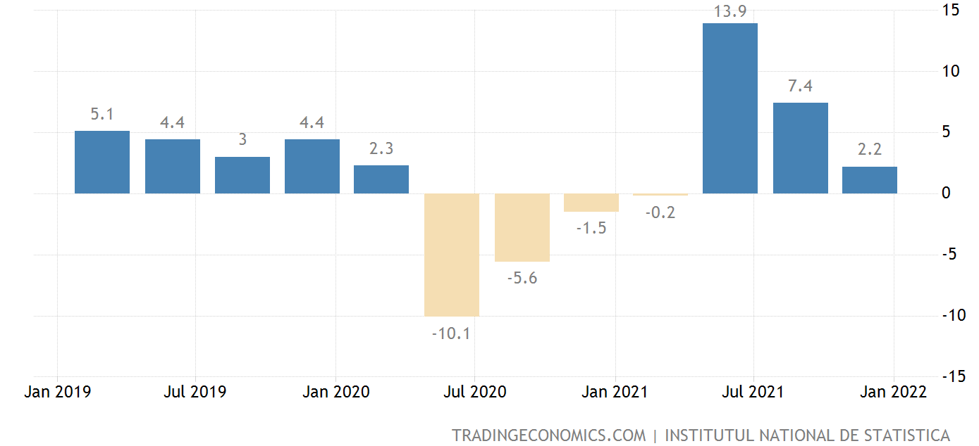
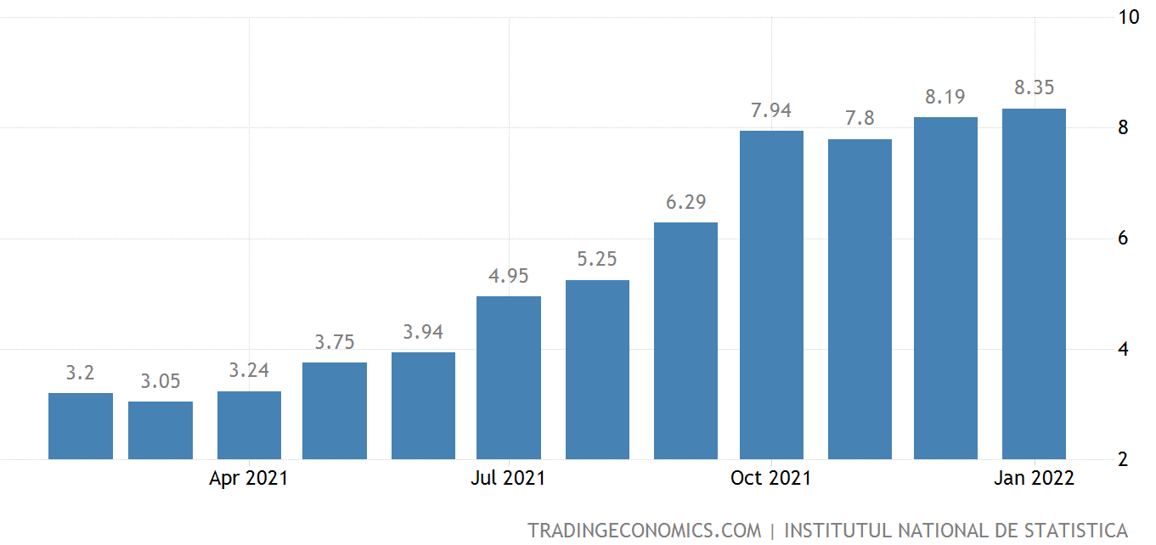
Romanian Macro development
The Romanian economy’s recovery to pre-pandemic levels has been driven, amongst others, by consumption, which, in turn, was sustained by the resilient labour market.
The slowdown in the fourth quarter of 2021 may be explained by the rising energy prices. Such a re-alignment process undergone by the energy prices will most likely have a detectable permanent impact on the economic activity.
The Romanian GDP advanced by 2.2% year-on-year in the fourth quarter of 2021, easing sharply from a 7.4% growth in the previous period. For 2021 full year, the GDP grew by 5.6 percent, recovering sharply from a 3.7 percent drop in 2020.
The 12 month inflation rate up to January 2022 was 8.35%.
Romania quarterly GDP evolution (Data INS)
Romania Inflation Rate (Data INS)

Slide 11
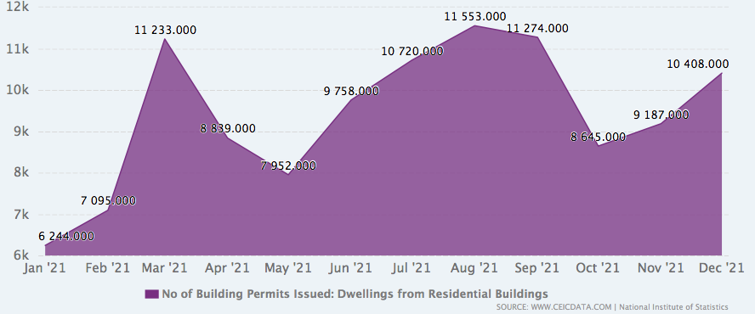
Romania Real Estate Update
No of Building Permits Issued: Dwellings from Residential Buildings data was reported at 10,408. Unit in Dec 2021. This records an increase from the previous number of 9,187. Unit for Nov 2021. No of Building Permits Issued: Dwellings from Residential Buildings data is updated monthly, averaging 5,729. Unit from Jan 2004 to Dec 2021, with 216 observations. The data reached an all-time high of 13,821. Unit in Mar 2008 and a record low of 1,080. Unit in Jan 2004. No of Building Permits Issued: Dwellings from Residential Buildings data remains active status in CEIC and is reported by National Institute of Statistics. The data is categorized under Global Database’s Romania.
Romania Residential Building Permits December 21 (Data CEIC)
RomReal Limited – Fourth quarter 2021

Slide 12
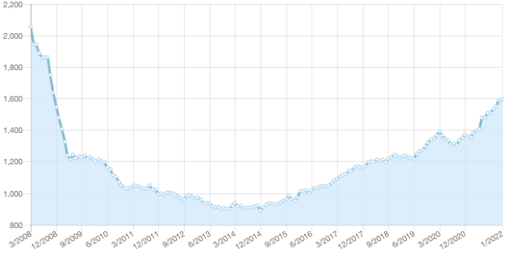
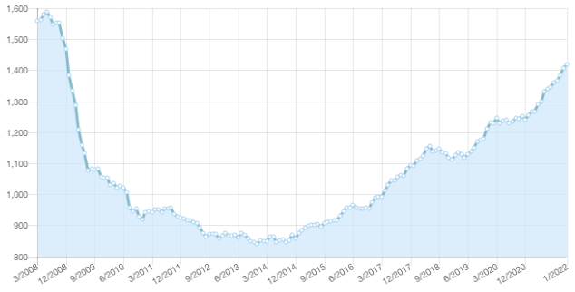
Apartment Price Development (End December 21)
Asking prices for apartments and houses in Romania gained 5.7% in the fourth quarter of 2021 compared third quarter of 2021. Q4 2021 average residential prices in Romania reached an average price of EUR 1,593/sqm and EUR 1,596/ m2 at the end of January 2022 compared to 1,507/sqm at the end of the previous quarter.
Romania
In Constanta, average prices increased by 3.5% during the fourth quarter of 2021 (EUR 1,408/sqm at the end of December 2021, compared to EUR 1,360/sqm at the end of September 2021), according to www.imobiliare.ro index.
Constanta
RomReal Limited – Fourth quarter 2021

Slide 13
RomReal shareholders as at 21/02/2022
Rank | Name | Holding | Stake
1 | SIX SIS AG | 10,331,934 | 24.98%
2 | GRØNSKAG, KJETIL | 5,752,914 | 13.90%
3 | THORKILDSEN, WENCHE | 5,392,985 | 13.04%
4 | SAGA EIENDOM AS | 3,311,526 | 8.01%
5 | AUSTBØ, EDVIN | 2,108,500 | 5.10%
6 | Danske Bank A/S | 1,507,924 | 3.65%
7 | ENERGI INVEST AS | 1,253,611 | 2.66%
8 | ORAKEL AS | 1,101,000 | 2.66%
9 | GRØNLAND, STEINAR | 1,002,522 | 2.42%
10 | Bnp Paribas Securities Services | 991,717 | 2.40%
11 | SPAR KAPITAL INVESTOR AS | 940,236 | 2.27%
12 | THORKILDSEN INVEST AS | 829,478 | 2.01%
13 | PERSSON, ARILD | 718,000 | 1.74%
14 | HOEN, ANDERS MYSSEN | 689,557 | 1.67%
15 | KVAAL INVEST AS | 576,000 | 1.39%
16 | AKSEL MAGDAHL | 457,403 | 1.11%
17 | NORDNET LIVSFORSIKRING AS | 443,629 | 1.07%
18 | FRENICO AS | 396,000 | 0.96%
19 | CITIBANK | 220,000 | 0.53%
20 | NORDNET BANK AB | 206,961 | 0.50%
 | TOP 20 | 39,231,897 | 92.42%
(1) This is the Top 20 Shareholder list as per 21 February 2022.
(2) The total issued number of shares issued at end Q4 2021 was 41,367,783.
(3) Thorkildsen Invest AS is a Company controlled by RomReal Kay Thorkildsen family.
(4) Chairman Kjetil Grønskag owns directly and indirectly 5,752,914 shares corresponding to 13.90%.
RomReal Limited – Fourth quarter 2021

Slide 14
Main focus areas going forward
RomReal, according to the strategy, is focusing on land value enhancing activities
In order to speed up an exit and target a higher profitability on the attractive located Oasis project, the Board of Directors have decided to provide the financial resources to complete the two apartment structures and upgrade the four houses on the property. This in addition to the infrastructure required on the Oasis project.
An improved but uncertain sales progress combined with vendor financing, further infrastructure investments to improve marketability, indicate a complete sale of the entire portfolio could easily drag out for another 2-3 years.
RomReal Limited – Fourth quarter 2021

Slide 15
Thank you
Investor Relations
Kjetil Gronskag
+40 731123037 | investors@romreal.com
16 Burnaby Street, Hamilton HM11, Bermuda
For further information on RomReal, including presentation material relating to this interim report and financial information, please visit www.romreal.com
DISCLAIMER
The information included in this Report contains certain forward-looking statements that address activities, events or developments that RomReal Limited (“the Company”) expects, projects, believes or anticipates will or may occur in the future. These statements are based on various assumptions made by the Company, which are beyond its control and are subject to certain additional risks and uncertainties. The Company is subject to a large number of risk factors including but not limited to economic and market conditions in the geographic areas and markets in which RomReal is or will be operating, counterparty risk, interest rates, access to financing, fluctuations in currency exchange rates, and changes in governmental regulations. For a further description of other relevant risk factors we refer to RomReal’s Annual Report for 2020. As a result of these and other risk factors, actual events and our actual results may differ materially from those indicated in or implied by such forward-looking statements. The reservation is also made that inaccuracies or mistakes may occur in the information given above about current status of the Company or its business. Any reliance on the information above is at the risk of the reader, and RomReal disclaims any and all liability in this respect.

