Slide 1
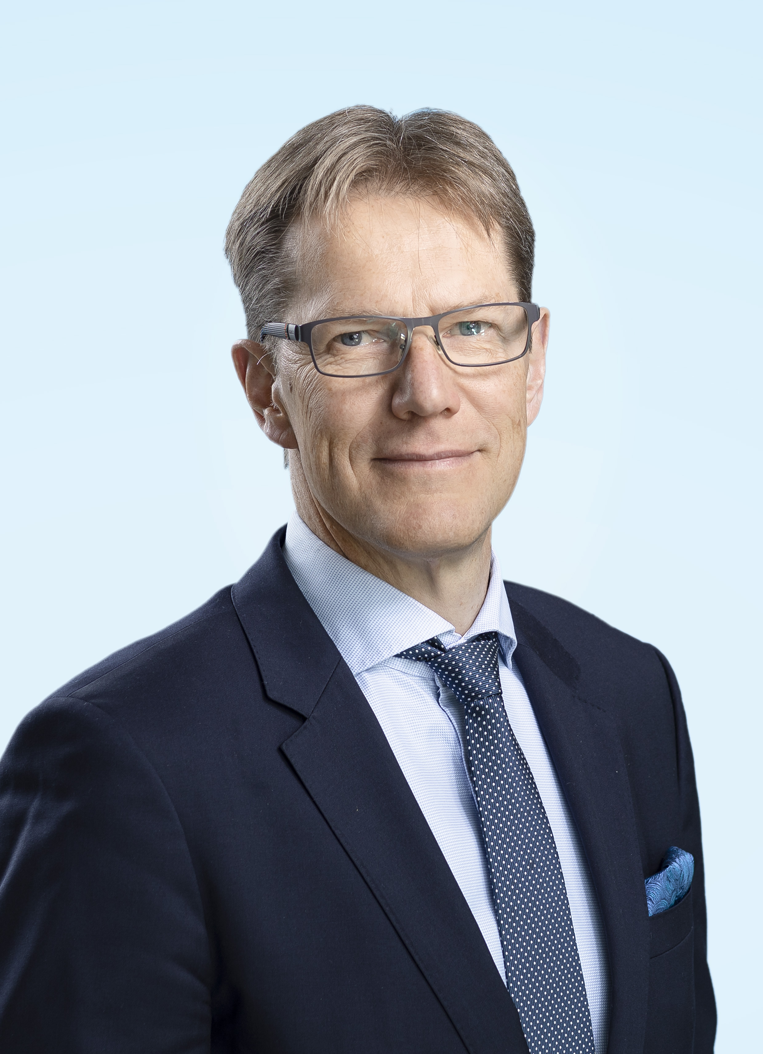
PETRI CASTRéN
Born 1962
Work history:
Kemira Oyj
2013 – CFO
Nokia Siemens Networks
2008 – 2013 Head of Corporate Finance (Group Treasurer)
2007 – 2008 Head of Corporate Development
Nokia Corporation
2006 – 2007 Vice President, Nokia NSN negotiation team lead and Head of Transition program
Nokia Networks
2005 – 2006 Vice President, Managed Services Engagement Team
Nokia Corporation
1999 – 2005 VP & Head of Mergers & Acquisitions Finland
EDUCATION:
1988 University of Helsinki, Master of Laws (LLM)
1996 University of Connecticut, Executive MBA Program, Master of Business Administration, Stamford, CT, USA

